Slide 1


Traditional Lithuanian toys
The European Commission’s support for the production of this publication does not constitute an endorsement of the contents, which reflect the views only of the authors, and the Commission cannot be held responsible for any use which may be made of the information contained therein. Project: “OUTSIDE- Open commUniTies for SustaInable
DevelopmEnt” Nr. 2020-1-IT02-KA201-079803 - Nr. 2020-1-IT02-KA201-079803

Slide 2
As times change, so do traditions, and that goes for toys as well. Nowadays, children do not play with what my grandmother used to play with. Today's toys are mostly made of rubber and plastic, which is not good for our environment. That's why we want to revive the old traditions and remind people how to make old toys, because it's not only interesting to play with them, but also to make them yourself.

Slide 3
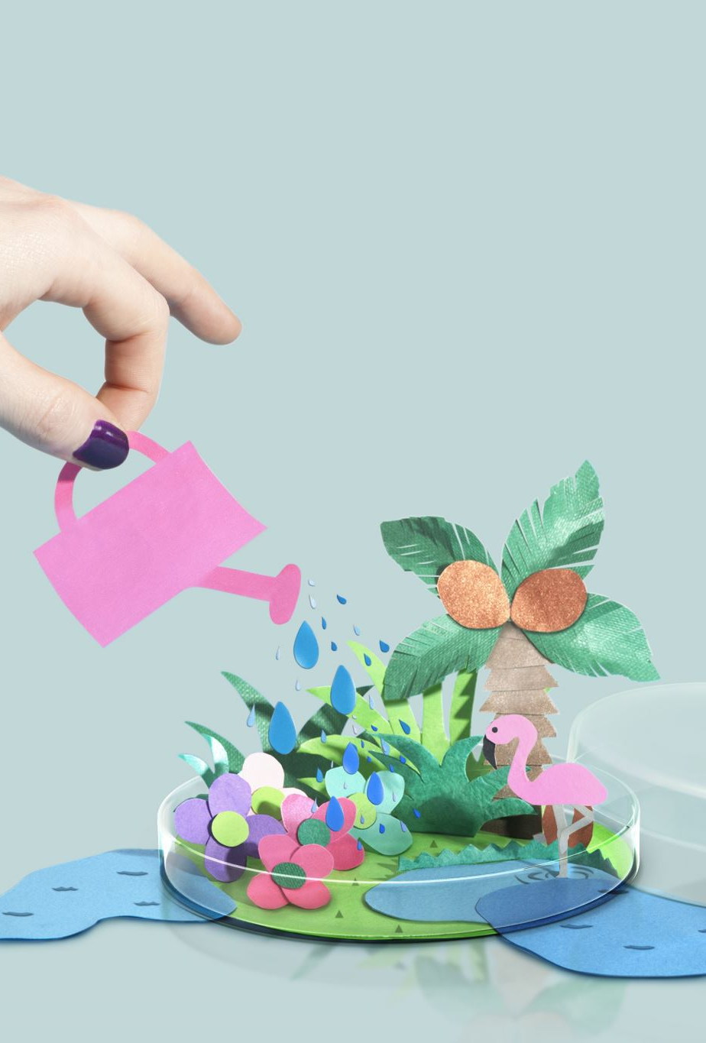
Our idea
We want to encourage people to preserve nature in our town. The idea is to create a company that will motivate each of us to keep the surrounding nature clean. We will make toys that are environmentally friendly and will attract people. We want to involve the local community and people of different generations more in our activities. We will promote active and meaningful recreation.

Slide 4
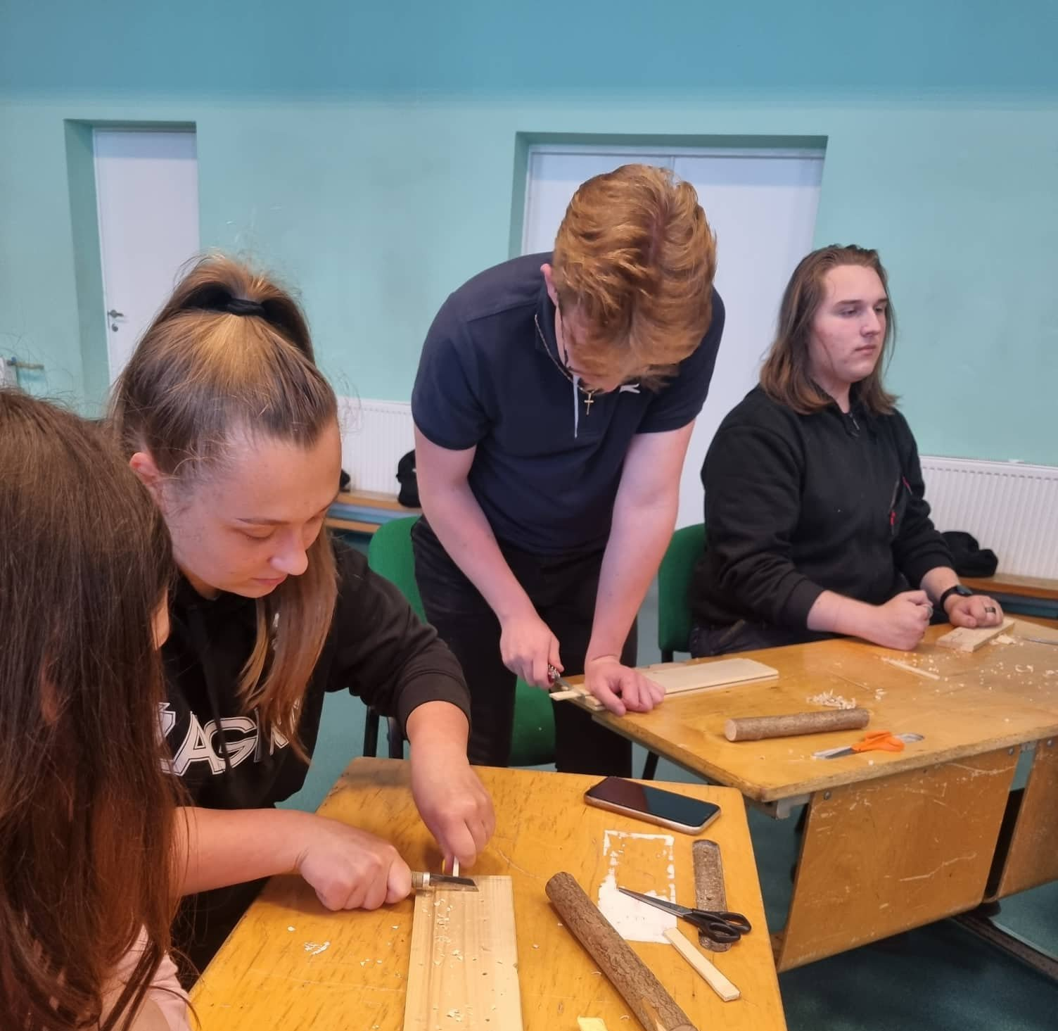
Our team has worked for a long time and made several toys from wood, yarn and other materials that protect nature. Today we will tell you how we did it and reveal the secrets of toy making.

Slide 5
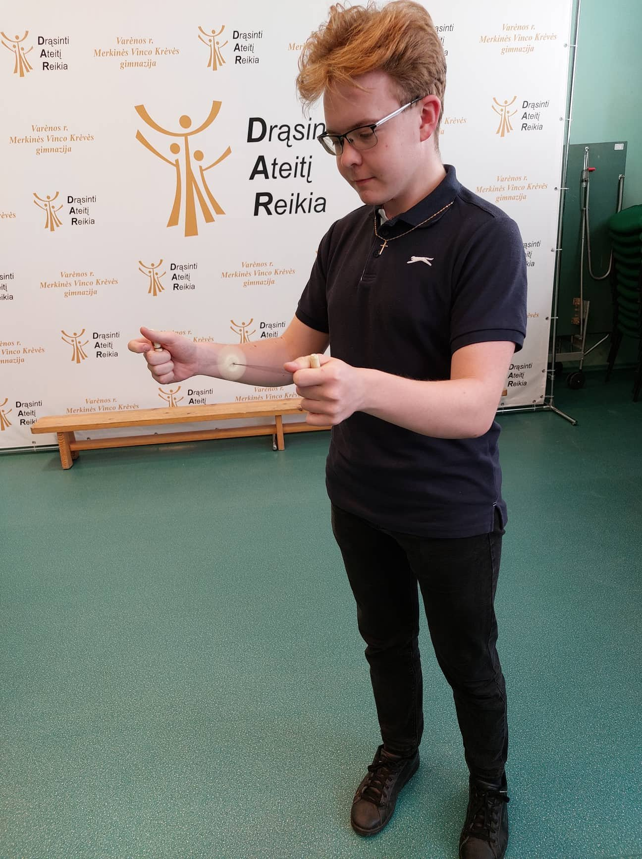
The Burzly (Burgzlys)
To make this toy, you will need yarn, wood, a pocket knife and a wooden board. First, we cut two small wooden sticks about 5 centimeters long, trim them to leave a neat, roll-shaped stick, and make a shallow depression in the center.
Then we need to cut a rectangular piece from the wooden board, about 4 centimeters long, 2 centimeters wide and 5 millimeters thick. Cut the piece also with a knife until it makes a smooth proportional surface, and round the ends. We mark the center and make two small holes on both sides about 5 millimeters from it to accommodate the thread.
Finally, we cut about 20 centimeters of the thread, pass it through both holes and tie a knot. To begin the game, wrap the thread around the stick so that it rests loosely on the depressions created and the wooden stick hangs in the middle. Holding the sticks in both hands, screw in the middle piece of wood and pull your hands in different directions. If you do everything correctly, you will hear a whistling sound.

Slide 6
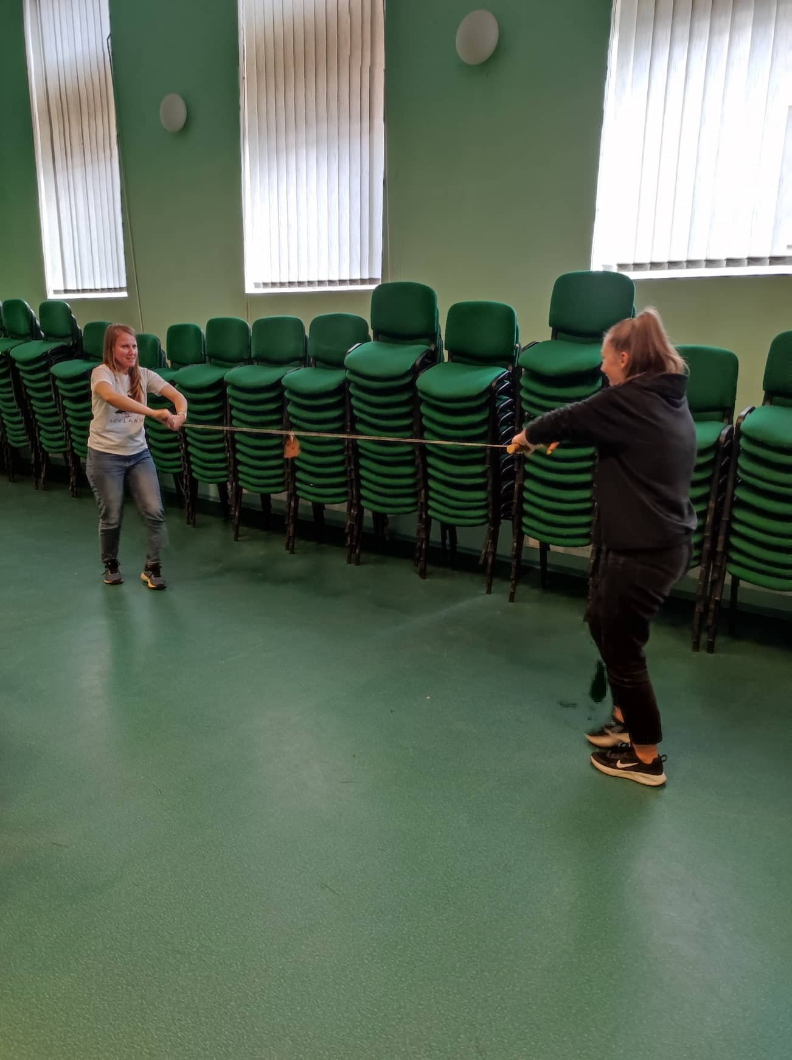
Rope roller
To make this toy, you will need two small sticks about 30 centimeters long, a rope and a piece of cloth. Take the rope and tie both ends tightly to the two sticks in the middle. Stretch the rope and attach a piece of cloth in the middle of the rope. How to play:
Invite a friend, take one stick and give the other to your friend. Move it so that the rope is stretched a little, give a starting signal and wrap the rope around the stick as quickly as possible, the first person to wrap the rope into a piece of cloth wins.

Slide 7
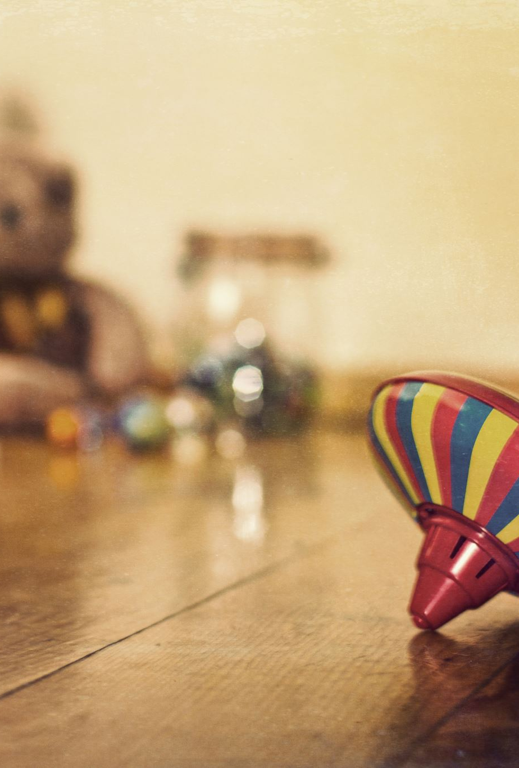
These products are made from natural and secondary raw materials. This idea is original and we hope that people will like them and use them. With our toys, everyone can learn about traditions, activities and games. The toys we make are used for active leisure. They are not difficult to make and do not harm our nature at all. Therefore, we will try to replace all plastic toys and reintroduce the old traditional toys. Nature gives us many things we need - trees, oxygen, food and water, so we have to love and protect it.

Slide 8
https://www.facebook.com/profile.php?id=100081634067513

