Slide 1


3D Printers
The European Commission’s support for the production of this publication does not constitute an endorsement of the contents, which reflect the views only of the authors, and the Commission cannot be held responsible for any use which may be made of the information contained therein. Project: “OUTSIDE- Open commUniTies for SustaInable DevelopmEnt” Nr. 2020-1-IT02-KA201-079803 - Nr. 2020-1-IT02-KA201-079803

Slide 2
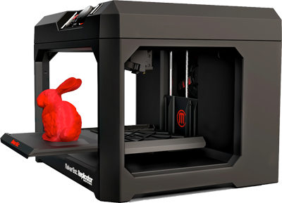
3D printers are tools that can take a 3D digital model created with basic 3D modelling software and turn it into something you can touch. This makes them a perfect tool to turn your imagination into reality.

Slide 3
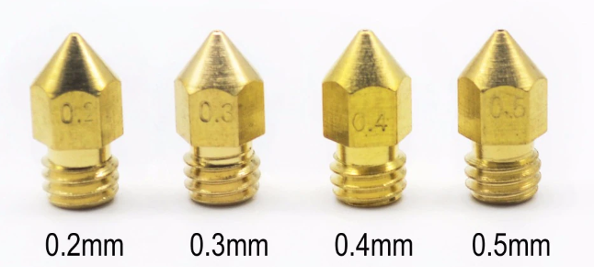
How do they work?
The printing material is transported in a form of a plastic string which then gets fed into a heated nozzle. The nozzles vary on the type of used filament, because some filaments require higher or lower temperatures than others. The nozzles can be changed to change the printing speed and texture of the final product.

Slide 4
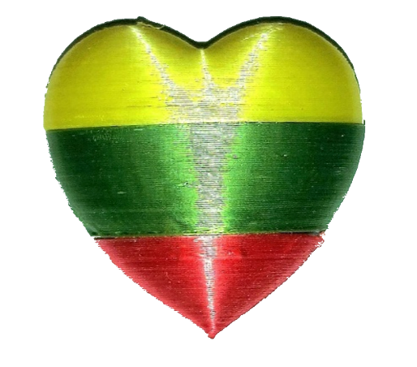
With the help of motors, we can move the nozzle or the 3D printer’s printing base itself. Within the 3D modeling software, we can change the size of the printed product and the size of the printing nozzle. The smaller the plastic comes out of the nozzle, the finer and smoother the finished product will be. Our main product will be small accessories such as these tiny hearts with which you‘ll be able to show appreciation to your country.

Slide 5
What comes to mind when someone says “3d printer”?
Miniature figurines
Tiny accessories
Ability to create useful tools
But barely anyone thinks about the material itself: Plastic

Slide 6
Our 3D printer filament is different
All this time we were talking about using plastic as a 3D printer’s main material, but by using a bio-degradable 3D printer filament created by a Lithuanian company called “Filalab”, we can create products that not are not only stylish but also don’t pollute the environment.

Slide 7
With the help of our IT specialist Dainius Žagunis, who volunteered to help in creating and printing objects, and Merkinė Vincas Krėvė gymnasium‘s available 3D printer this project can come to fruition.

Slide 8
Thank you for listening
Presentation prepared by the students of Merkinė Vincas Krėvė gymnasium
Matas Burdulis and Edis Lubas

