Slide 1



Session 2 – Green idea and opportunity generation
OUTSIDE module 6
Green Business Strategy
The European Commission's support for the production of this publication does not constitute an endorsement of the contents, which reflect the views only of the authors, and the Commission cannot be held responsible for any use which may be made of the information contained therein.
OUTSIDE - Open commUniTies for SustaInable DevelopmEnt Nr. 2020-1-IT02-KA201-079803

Slide 2
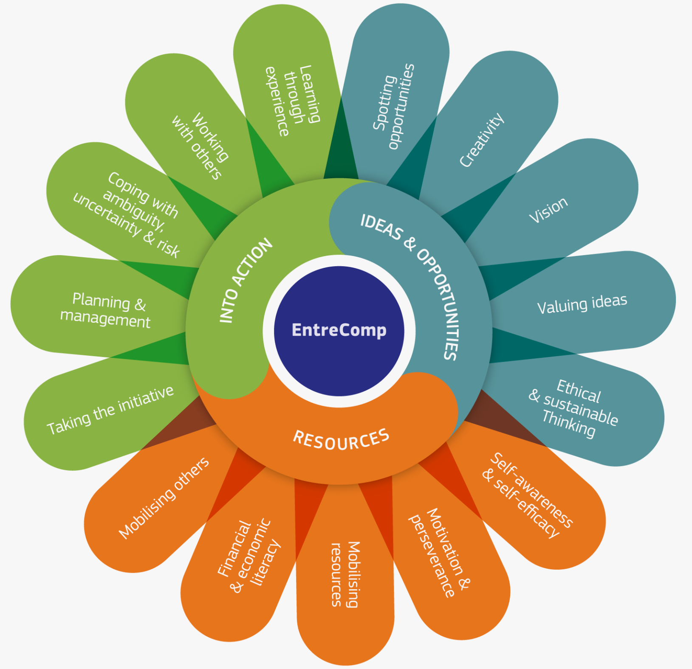
Introduction
This session explores how to generate ideas and opportunities for a green business venture.
Participants will use an adaptation of the EntreComp ideas & opportunities generation steps to leverage opportunity spotting, creativity, developing a vision for the future, value creation, and to realise positive impact analysis.
This session is mapped to "Phase 2 THINK OUTSIDE THE BOX"
Image source: https://ec.europa.eu/jrc/en/entrecomp/competence-areas-and-learning-progress

Slide 3
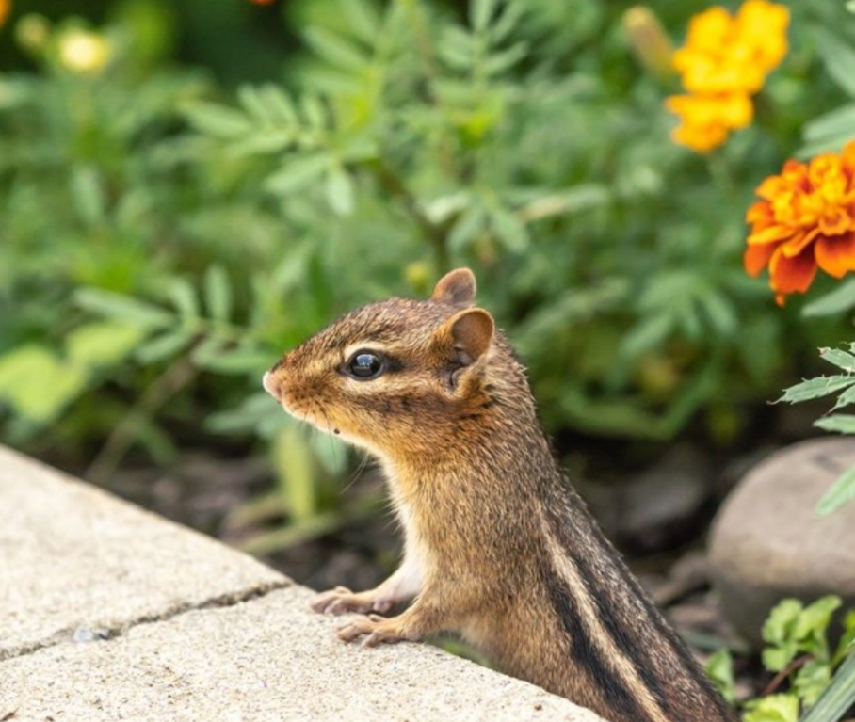
Session aim/purpose:
To use the Green growth and circular economy framework to plan how to embed green thinking at the heart a business idea.
To use the OUTSIDE idea approach to generate ideas and opportunities for a green business venture.
To strategize and create a vision for the future and a value proposition.
Image source: https://www.instagram.com/p/CU-WiEjo8z5/

Slide 4
Session outline
Activities breakdown | Duration
Slide Presentation: Explore the Green growth and circular economy and ideation. | 35 minutes
Activity 1: Green idea generation exercise | 60 minutes
Activity 2: Options analysis and idea selection | 30 minutes
Activity 3: Verbal team idea presentation | 30 minutes
Feedforward: Formative feedforward to group, linking theory and concepts to a real-life scenario. | 30 minutes
Debriefing: Q&A session to identify gaps in learning and address them (Q&A, quiz, or case study). | 20 minutes
Activity 4: Personal reflection and optional homework. | 60 minutes
Assessment: Complete a training evaluation form | 5 minutes

Slide 5

Group discussion
Video (4 mins +): Watch the video on biodiversity on Edpuzzle and answer the questions as they are presented:
https://edpuzzle.com/media/5f285d5d61744a3f1ce0010a
Group: Group discusses video on biodiversity.
YouTube video: https://www.youtube.com/watch?v=GK_vRtHJZu4

Slide 6

Note to trainer:
Slide Presentation: Explores concepts laid out in the Green growth and circular economy framework
(35 minutes).
Refer and use the Module 6 Green Business Strategy descriptor information in the OUTSIDE Toolkit.
Adapt all content to suits the age range of 14 to 17 years.
Image source: https://www.instagram.com/p/CT7Ai83KVID/

Slide 7
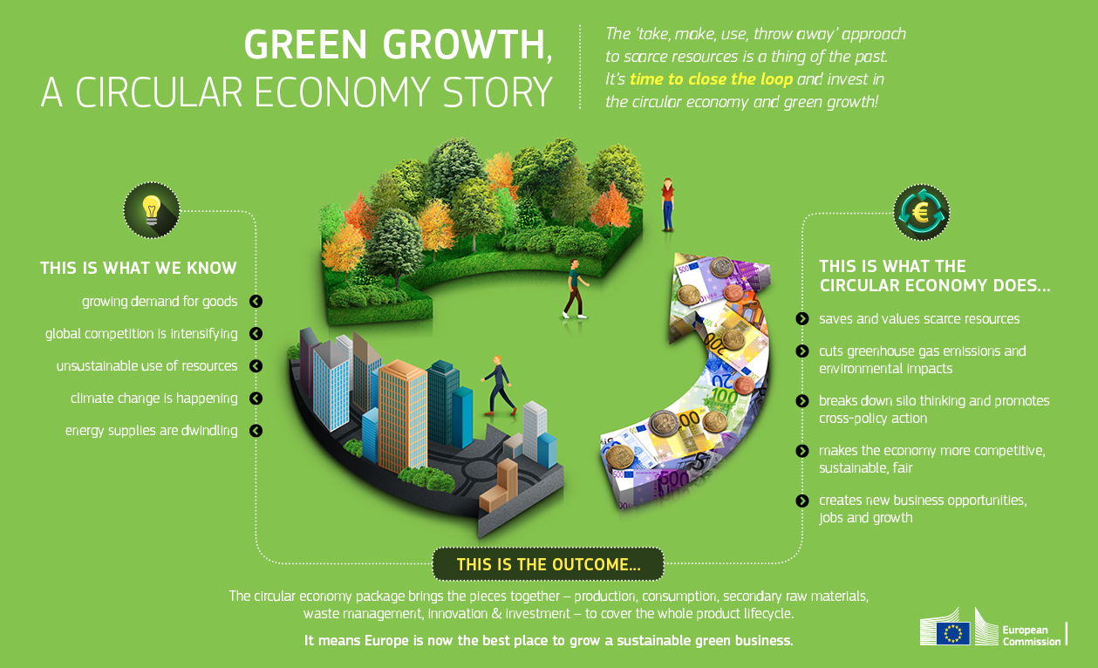
Weblink: https://ec.europa.eu/environment/green-growth/index_en.htm

Slide 8
Teamwork - Green idea and opportunity generation
Aim of the activities
Based on the outcome of Session 1 (Understanding Green Business Enterprise & Sustainable Development), participants work in teams to generate a green business idea that solves a real-life challenge.
Participants will work as a team to generate an innovative green business idea by exploring current green business ideas, placing sustainability issues in context, and generating a new green initiative, backed up with evidence of research.

Slide 9
Spotting opportunities: Using tools for thinking and idea generation techniques
Think-Pair-Share: With reference to the outcome from Session 1, participants will work in teams and brainstorm a green business idea. Participants should aim to explore various types of idea generation techniques.
For instance:
Compare and contrast techniques listed on the Outside Idea Generation Template.
Find and review examples of how three of the techniques have been used to initiate green business ideas.
This task takes the form of team collaboration and team discussion. Trainer facilitates this session and encourage co-creation using the EntreComp competencies on the next slide.

Slide 10
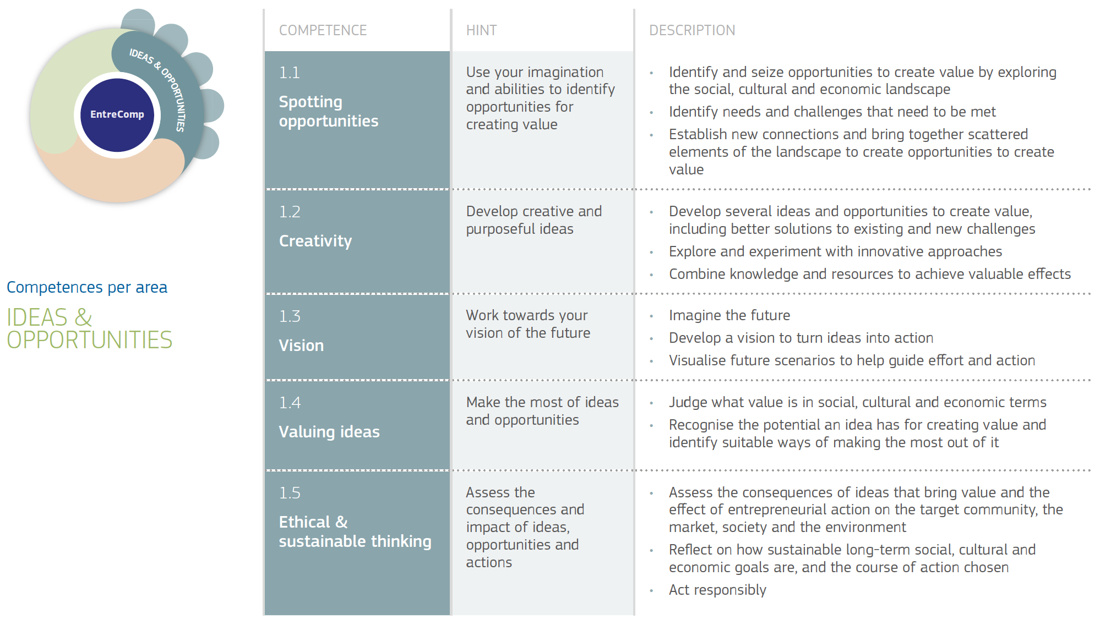
Think-Pair-Share
Weblink: https://ec.europa.eu/environment/green-growth/index_en.htm
Refer to the EntreComp competencies.
Discuss and apply steps
in the next set of activities
Source: https://ec.europa.eu/jrc/en/entrecomp/competence-areas-and-learning-progress (Pg 15)

Slide 11
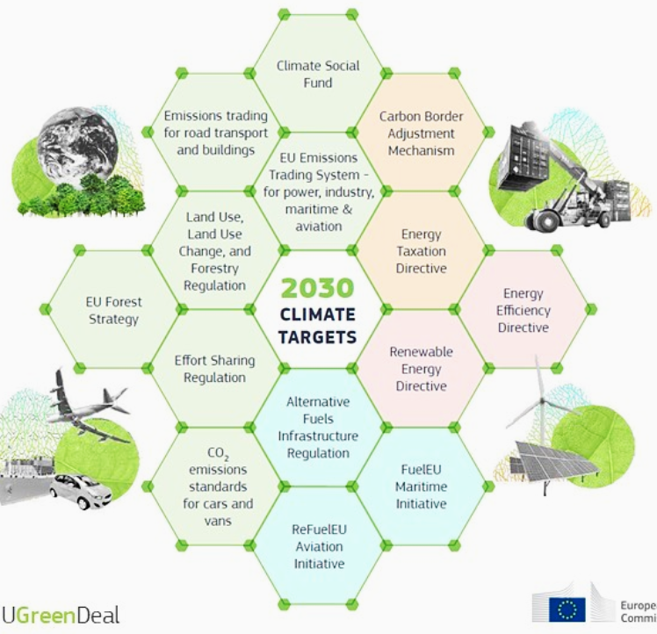
Idea generation tools for thinking
Image source: https://www.instagram.com/p/CRlP5Lrsy0d/

Slide 12
Tools for thinking and idea generation techniques
Some idea generation techniques
Brain-writing | Mind Mapping
Brainstorming | Reverse Thinking
Collaboration | SCAMPER
Research | Storyboarding
Focus groups | Synectics
Idea Napkin | The 5 W’s
Listening | Observation
Using tools for idea generation fosters creative thinking: Participants are able to generate a good range of ideas. Idea generation techniques are creative thinking processes that facilitates “thinking outside the box”.
Thinking outside the box means participants can use unconventional ways to generate a range of variables and questions that could leverage new idea to address issues of the given scenario.
Your can read more about idea generation on this webpage: Idea Generation and Optimisation: - https://www.optimizationgroup.com/solutions/idea-generation-optimization/

Slide 13
Activity 1 instruction
60 minutes
Activity 1 - Team green idea generation:
Reflect and discuss the green growth and circular economy (Slide 6).
Reflect on the EntreComp competencies and discuss how to apply the steps (Slide 9).
Generates three separate green business ideas based on slides 6 and 9.
For each idea, complete the OUTSIDE idea approach template on Slide 13

Slide 14
Outside idea generation template
What is your green idea:
Team name: |  |  |  | Date: | Idea No:
1 - Briefly describe the issue(s) |  |  | State issue 1:
 |  |  | State issue 2:
2 - What is the impact of the issue(s)? |  |  | 4 - What makes your idea "green" or "sustainable"?
3 - How does your team idea solve the issue? |  |  | 5 - The idea benefit(s)
 |  |  | Society: | Environment: | Business:

Slide 15
Activity 2 instruction
30 minutes
Activity 2 - Team green idea selection and justification:
Review and discuss the merits of each green idea generated.
Watch the video on how to complete a decision matrix table (https://youtu.be/jTMjg2Ftes0)
Use the Outside decision matrix template to rate the three green ideas (Slide 15).
Review and select the “best fit” green idea from Outside decision matrix template.
Selection justification: Write up the reason why the top idea is the “best fit” green idea.

Slide 16
Outside decision matrix
Option/idea selection |  | Rating = a score between 0 and 5 Options analysis = Score (n)*Weight
Selection Criteria | Weight | Idea 1 | Idea 2 | Idea 3
Saves and values scarce resources | 25% | (n)*0.25 | (n)*0.25 | (n)*0.25
Minimise environmental impacts | 25% | (n)*0.25 | (n)*0.25 | (n)*0.25
Builds communities and partnership | 20% | (n)*0.20 | (n)*0.20 | (n)*0.20
Promotes sustainable and fair competition | 15% | (n)*0.15 | (n)*0.15 | (n)*0.15
Creates new business opportunities and growth | 15% | (n)*0.15 | (n)*0.15 | (n)*0.15
Option selection score/rating: | 100%

Slide 17
Activity 3 instruction
30 minutes
Activity 3 - Verbal team idea presentation:
As a team, create slides to show your findings for Activity 1 and 2.
Each team should appoint a spokesperson to present on behalf of their team.
Team members should prepare to address questions and further the discussion.
Reflection: Participants should be encouraged to take a picture of the various contributions showcased (or share files), to add to their individual e-journal and reflect on in 100 words.

Slide 18
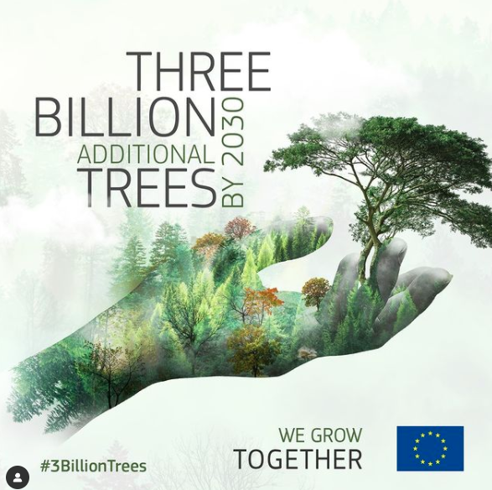
Debriefing
Trainers wraps up the session by running a questions and answers session to identify gaps in knowledge and addresses them.
Trainers briefs participants about Activity 4 which is optional homework.
Participants complete training evaluation form.
Image source: https://www.instagram.com/p/CXROqPRo_mf/

Slide 19









Any questions?
The European Commission's support for the production of this publication does not constitute an endorsement of the contents, which reflect the views only of the authors, and the Commission cannot be held responsible for any use which may be made of the information contained therein.
OUTSIDE - Open commUniTies for SustaInable DevelopmEnt Nr. 2020-1-IT02-KA201-079803

