Slide 1



Session 3 – Developing a green business model canvas
OUTSIDE module 6
Green Business Strategy
The European Commission's support for the production of this publication does not constitute an endorsement of the contents, which reflect the views only of the authors, and the Commission cannot be held responsible for any use which may be made of the information contained therein.
OUTSIDE - Open commUniTies for SustaInable DevelopmEnt Nr. 2020-1-IT02-KA201-079803

Slide 2

Introduction
Session 3 turns the outcomes sessions 1 and 2 into a developed green business model canvas.
Participants focus on justifying a value proposition that meets real people needs without compromising on environmental sustainability.
Participants learn how to use the business model canvas to explain key aspects of the green business proposition.
This session is mapped to "Phase 3 GO OUTSIDE".
Image source: https://www.instagram.com/p/CXQ1L2Qtyno/

Slide 3
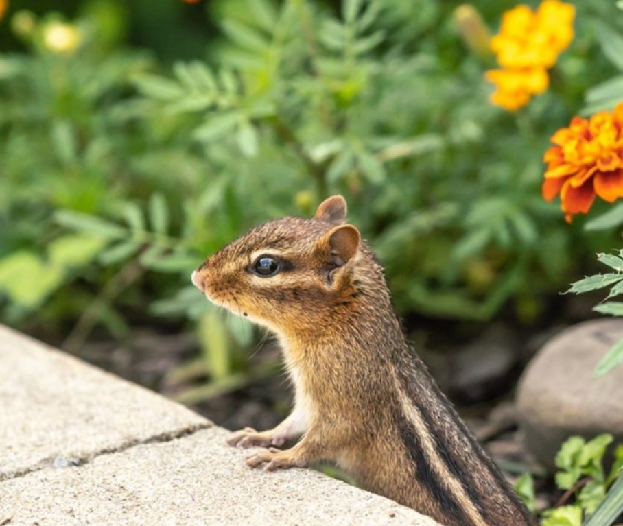

Session aim/purpose:
To further develop a green business value proposition based on session 2 output.
To translate the result of the a VPC into a fully developed green business BMC.
To appraise the benefits of a BMC and a traditional business plan.
Image source: https://www.instagram.com/p/CXQncpPNrhq/

Slide 4
Session outline
Activities breakdown | Duration
Slide Presentation: Developing a Value Proposition Canvas (VPC) and a green Business Model Canvas (BMC). | 35 minutes
Activity 1: Review, discuss, and complete a the VPC template based on Session 2 | 60 minutes
Activity 2: Review, discuss, and complete a the BMC template based on Session 2 | 60 minutes
Feedforward: Formative feedforward to group, linking theory and concepts to a real-life scenario. | 30 minutes
Debriefing: Q&A session to identify gaps in learning and address them (Q&A, quiz, or case study). | 20 minutes
Activity 3: Personal reflection and optional homework. | 60 minutes
Assessment: Complete a training evaluation form | 5 minutes

Slide 5

Note to trainer:
Slide Presentation: Developing a Value Proposition Canvas (VPC) and a green Business Model Canvas (BMC) (35 minutes):
Refer and use the Module 6 Green Business Strategy descriptor information in the OUTSIDE Toolkit.
Adapt all content to suits the age range of 14 to 17 years.
Image source: https://businessmodelanalyst.com/product-category/free-downloads/

Slide 6
Teamwork - Developing a green business value proposition and a business model canvas
Aim of the activities
Participants work in teams to formalise a green business value proposition that creates positive social consequences.
Participants will work to develop, discuss, and embed the value proposition (output of session 2) into a green business model canvas.

Slide 7

Developing value proposition canvas
Image source: https://www.instagram.com/p/CRlP5Lrsy0d/
Image source: https://www.instagram.com/p/CVLQcxXolcw/

Slide 8
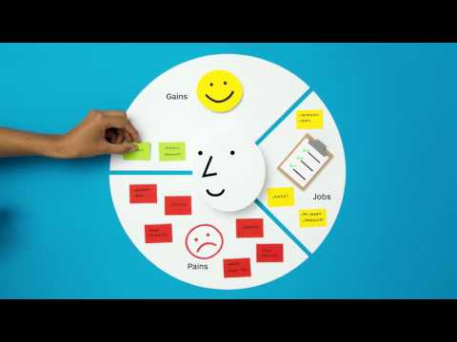
Group discussion
Video 1 (3 mins +): Watch a video on how to create a value proposition that meets real customer needs:
https://youtu.be/ReM1uqmVfP0
Group: In your group, discuss the video in relation to the team’s business idea generated in session 2.
YouTube video: https://youtu.be/ReM1uqmVfP0

Slide 9
Activity 1 instruction
60 minutes
Activity 1 - developing a value proposition:
Team reviews the VPC template to understand its usefulness for strategic thinking.
Team completes VPC template for the green business idea generated in session 2.
  VPC template shown on next slide -- Value Proposition Canvas free Template
Team pins up an A3 VPC in class for an open discussion.
All participants in the class contribute to the open and interactive discussion about each VPC, reviewing the merits of each template.

Slide 10
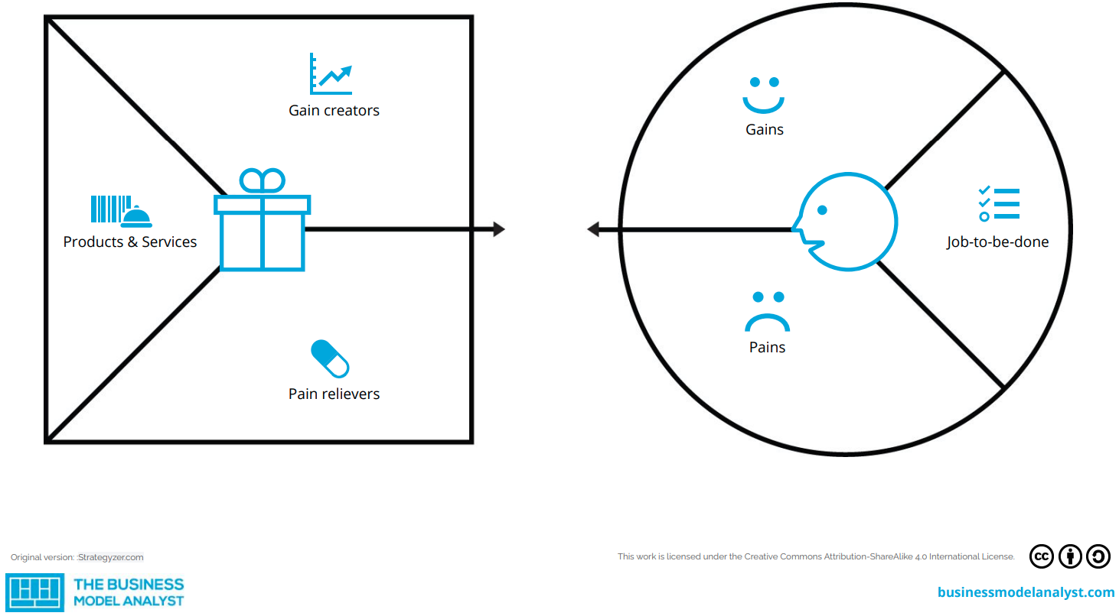

Slide 11

Developing business model canvas
Image source: https://www.instagram.com/p/CRlP5Lrsy0d/
Image source: https://www.instagram.com/p/CXQ8DTVNj0V/

Slide 12
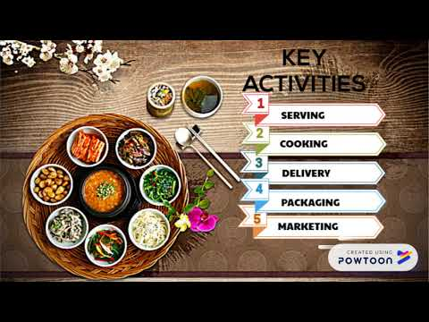
Group discussion
Video 2 (2 mins +): Watch an example of a developed business model canvas example:
https://youtu.be/JXJeTfMplFs
Group: In your group, discuss the video in relation to the team’s business idea generated in session 2.
YouTube video: https://youtu.be/JXJeTfMplFs

Slide 13
Activity 2 instruction
60 minutes
Activity 2 - developing a business model canvas:
Team reviews the BMC template to understand its usefulness for strategic thinking.
  Why is the BMC such a useful template for defining a new business venture?
  Why is it important to define and understand the Customer Relationships aspect of the BMC?
Team reviews and discusses the 10 building blocks of the BMC
Team completes BMC template for the green business idea generated in session 2.
BMC template shown on next slide -- Business Model Canvas Template Google Slides
Team pins up an A3 BMC in class for an open discussion. All participants contribute to the discussions.

Slide 14
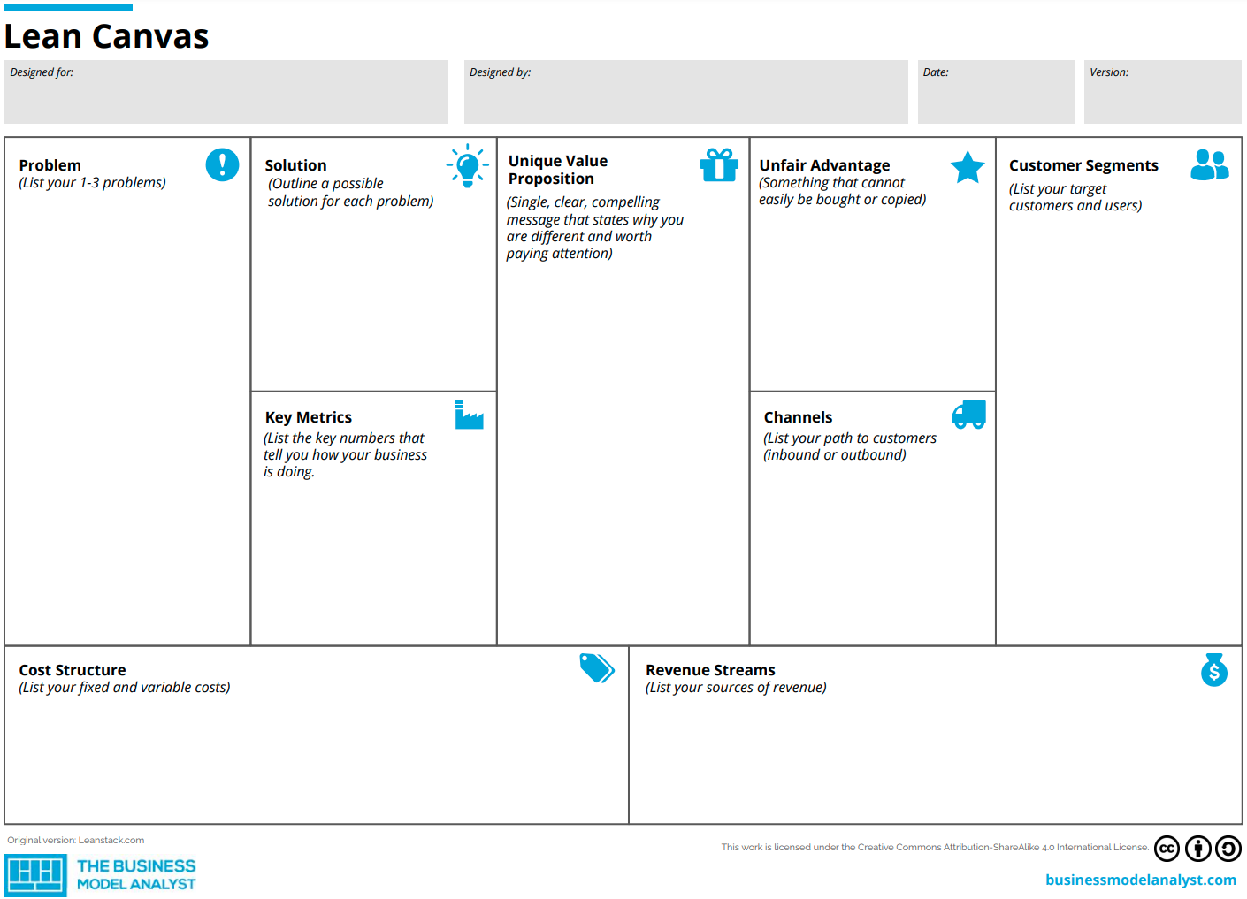

Slide 15
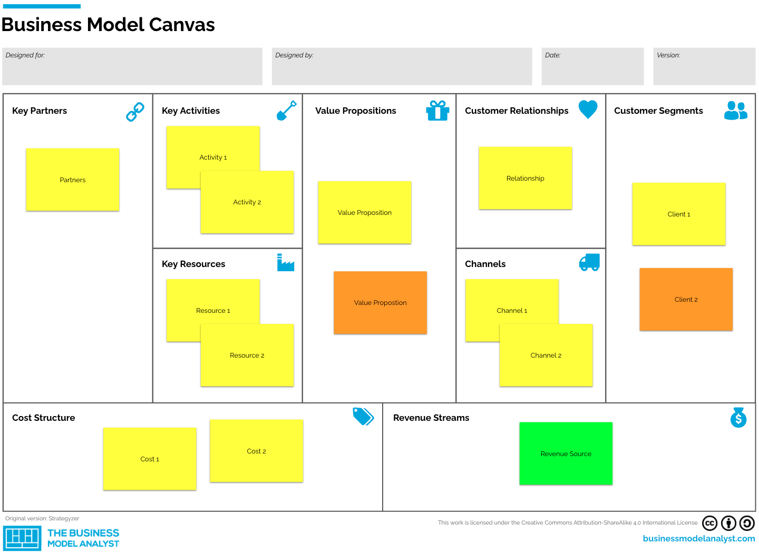

Slide 16
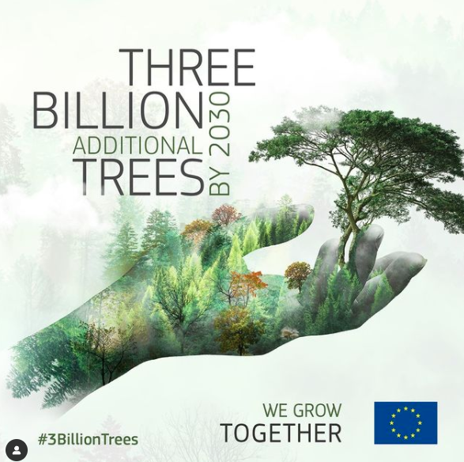
Debriefing
Trainers wraps up the session by running a questions and answers session to identify gaps in knowledge and addresses them.
Trainers briefs participants about Activity 3 which is optional homework.
Participants complete training evaluation form.
Image source: https://www.instagram.com/p/CXROqPRo_mf/

Slide 17









Any questions?
The European Commission's support for the production of this publication does not constitute an endorsement of the contents, which reflect the views only of the authors, and the Commission cannot be held responsible for any use which may be made of the information contained therein.
OUTSIDE - Open commUniTies for SustaInable DevelopmEnt Nr. 2020-1-IT02-KA201-079803

