Slide 1



Session 4 – Green entrepreneurial mindset and business activities
OUTSIDE module 6
Green Business Strategy
The European Commission's support for the production of this publication does not constitute an endorsement of the contents, which reflect the views only of the authors, and the Commission cannot be held responsible for any use which may be made of the information contained therein.
OUTSIDE - Open commUniTies for SustaInable DevelopmEnt Nr. 2020-1-IT02-KA201-079803

Slide 2

Introduction
This final session focuses on the green entrepreneurial mindset.
Participants consider outputs of all previous sessions through the eyes of a pro-environment entrepreneur.
It introduces participants to: a) the role of enterprise, b) entrepreneurship, and c) entrepreneurial mindset.
This session is mapped to "Phase 3 GO OUTSIDE" and it can support Stakeholder Engagement.
Image source: https://www.instagram.com/p/CXQ1L2Qtyno/

Slide 3

Session aim/purpose:
To explore the concept of enterprise, entrepreneurship, & entrepreneurial mindset.
To explain the pro-environment entrepreneurial mindset
To explore the concept of start-up incubators
To examine options for growing a green economy
Image source: https://www.instagram.com/p/CXQncpPNrhq/

Slide 4
Session outline
Activities breakdown | Duration
Slide Presentation: Entrepreneurial Mindset for a Green Business Venture. | 35 minutes
Activity 1: Teamwork where participants carry out online research | 60 minutes
Activity 2: Teams give a pitch as a small start-up venture | 60 minutes
Feedforward: Formative feedforward to group, linking theory and concepts to a real-life scenario. | 30 minutes
Debriefing: Q&A session to identify gaps in learning and address them (Q&A, quiz, or case study). | 20 minutes
Activity 3: Personal reflection and optional homework. | 60 minutes
Assessment: Complete a training evaluation form | 5 minutes

Slide 5


Note to trainer:
Slide Presentation: Entrepreneurial Mindset for a Green Business Venture (35 minutes):
Refer and use the Module 6 Green Business Strategy descriptor information in the OUTSIDE Toolkit.
Adapt all content to suits the age range of 14 to 17 years.
Image source: https://businessmodelanalyst.com/product-category/free-downloads/

Slide 6
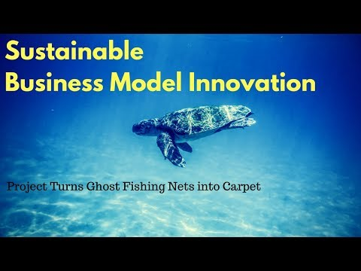
Teamwork - Green entrepreneurial mindset and business activities
Aim of the activities
Participants collaborate and explore ways to reduce strains on natural resources, increase eco-friendly clean and renewable energy, and innovate green business models to make them more sustainable.
YouTube video: https://youtu.be/Kr_1eaGAYKQ

Slide 7

Entrepreneurial Mindset for a Green Business Venture
Image source: https://www.instagram.com/p/CRlP5Lrsy0d/
Image source: https://www.instagram.com/p/CVLQcxXolcw/

Slide 8
Activity 1 instruction
60 minutes
Activity 1 - Exploring the green business mindset:
Each team to select one video to review.
Each team chooses from one of the video tasks below and addresses the given question.
  What skills and mindset must be developed to run a green business venture?
  Relate this to your green business proposition laid out in their completed BMC from session 3.

Slide 9
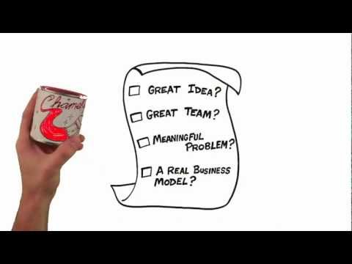
Team task 1
Video 1 (3 mins +): Watch a video on "Entrepreneurial Mindset": https://youtu.be/FOFm8fPP2Kc
Question:
From the video, what mindset should a startup entrepreneur have?
What are the key characteristics of a great start-up according to the video?
What type of people do you need to start you green business based on the video?
Record answers on an A3 paper, ready to pin up and present in class as a team.
YouTube video: https://youtu.be/FOFm8fPP2Kc

Slide 10
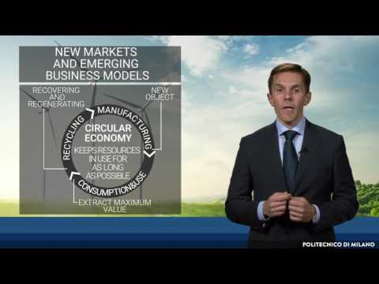
Team task 2
Video 2 (9 mins +): Watch a video on "Green entrepreneurship by Lorenzo Tosini: https://youtu.be/dQ4E5iC4ckI
Question:
What is green entrepreneurship about according to the video?
Tom Osborn become a green entrepreneur at the age of 18, what were his skills and competences?
How would you describe circular economy according to the video?
What are benefits of circular economy?
Record answers on an A3 paper, ready to pin up and present in class as a team.
YouTube video: https://youtu.be/dQ4E5iC4ckI

Slide 11
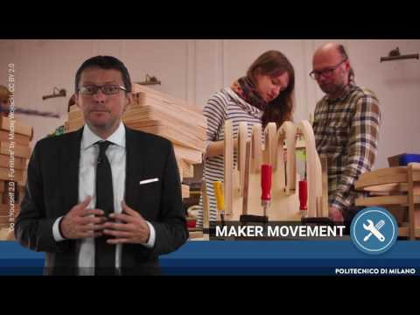
Team task 3
Video 3 (6 mins +): Watch a video on New business models by Mario Calderini : https://youtu.be/CiHHIQ5_jUg
Question:
What type of business model was used in iFoodShare according to the video?
How is the circular input model different from the lifecycle extension business model?
How would you describe the inclusive economy model?
How are the benefits of co-creation?
Record answers on an A3 paper, ready to pin up and present in class as a team.
YouTube video: https://youtu.be/CiHHIQ5_jUg

Slide 12
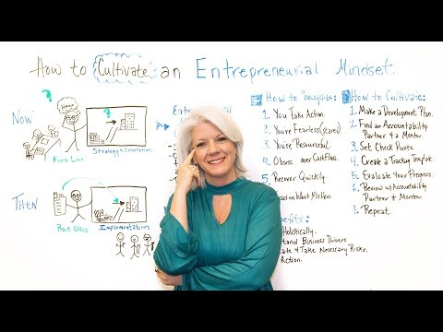
Team task 4
Video 4: (4 mins +): Watch a video on - How to Cultivate an Entrepreneurial Mindset: https://youtu.be/dulBMqkuHes
Question:
Based on the video how can you develop your entrepreneurial mindset?
What does it mean to cultivate an entrepreneurial mindset
Record answers on an A3 paper, ready to pin up and present in class as a team.
YouTube video: https://youtu.be/dulBMqkuHes

Slide 13

Green business pitch
Image source: https://www.instagram.com/p/CRlP5Lrsy0d/
Image source: https://www.instagram.com/p/CXQ8DTVNj0V/

Slide 14
Activity 2 instruction
60 minutes
Activity 2 - Overall project pitch and presentation
Teams give a pitch as a small start-up venture that is pro-environment and committed to sustainable development.
Create a set of PowerPoint presentation slides that addresses the following:
  Slide 1 OUTSIDE branded page showing; group business name and logo; mission statement; group project title; names of participants; session details and date.
  Slide 2 Demonstrate understanding and awareness of SD & green business
  Slide 3 Present biodiversity idea strategy using the Idea Model
  Slide 4 Showcase BMC, giving full green business justification.
  Slide 5 Present answers to session 4 group activity on this slide.
  Slide 6 Provide group reflection on pros and cons of the sessions.
  Slide 7 Provide referencing and any other useful resource found

Slide 15

Debriefing
Trainers wraps up the session by running a questions and answers session to identify gaps in knowledge and addresses them.
Trainers briefs participants about Activity 3 which is optional homework.
Participants complete training evaluation form.
Image source: https://www.instagram.com/p/CXROqPRo_mf/

Slide 16









Any questions?
The European Commission's support for the production of this publication does not constitute an endorsement of the contents, which reflect the views only of the authors, and the Commission cannot be held responsible for any use which may be made of the information contained therein.
OUTSIDE - Open commUniTies for SustaInable DevelopmEnt Nr. 2020-1-IT02-KA201-079803

