Slide 1



Session 3 – Mapping local environmental challenges
OUTSIDE module 4: How to turn an environmental challenge into a business opportunity
The European Commission's support for the production of this publication does not constitute an endorsement of the contents, which reflect the views only of the authors, and the Commission cannot be held responsible for any use which may be made of the information contained therein.
OUTSIDE - Open commUniTies for SustaInable DevelopmEnt Nr. 2020-1-IT02-KA201-079803

Slide 2
Introduction
In this session, participants will focus on mapping sustainable challenges observed with their local community. This session builds on the work done in session 1 and 2.

Slide 3
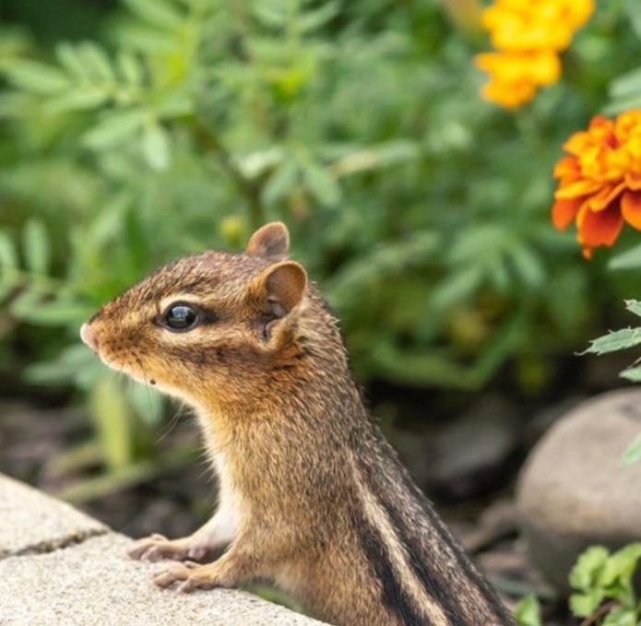
Session aim/purpose:
To scope an environmental challenge at local community level.
To rate the severity of each problem maped for further investigate.
Image source: https://www.instagram.com/p/CXQncpPNrhq/

Slide 4
Timeframe and content of the session
Activities breakdown | Duration
Slide Presentation: Explore how participants can develop skills to observe communities and identify environmental issues. | (20 minutes)
Activity: Interaction desk research and field research | (75 minutes)
Output: Group discussion, verbal presentation, and formative feedback. | (30 minutes)
Debriefing: Feedback to group, linking theory and concepts to a real-life scenario. Q&A session to identify gaps in learning and address them (Q&A, quiz, or case study) and what next. | (20 minutes)
Activity : Personal reflection and optional homework. | (60 minutes)
Assessment: Complete a training evaluation form | (5 minutes)
The overall duration of the session: 3 hours 30 minutes - (2 hours 30 minutes session + 1 hour homework)

Slide 5
Note to trainer:
Slide Presentation: Explores the value of observational research at the local community level. Strategies (20 minutes)
Trainer gives a short slide presentation or shows a video on what observational research is all about and how it is done.
Trainer explains why it is important to have a good knowledge about the area of study before they go and visit the case study local communities places.
Trainer makes the short session interactive and takes questions.
All aspects of access and safety will need to be considered and addressed as need be.

Slide 6
Teamwork - Developing a green business value proposition and a business model canvas
Aim of the activities
Participants work in teams to formalise a green business value proposition that creates positive social consequences.
Participants will work to develop, discuss, and embed the value proposition (output of session 2) into a green business model canvas.

Slide 7
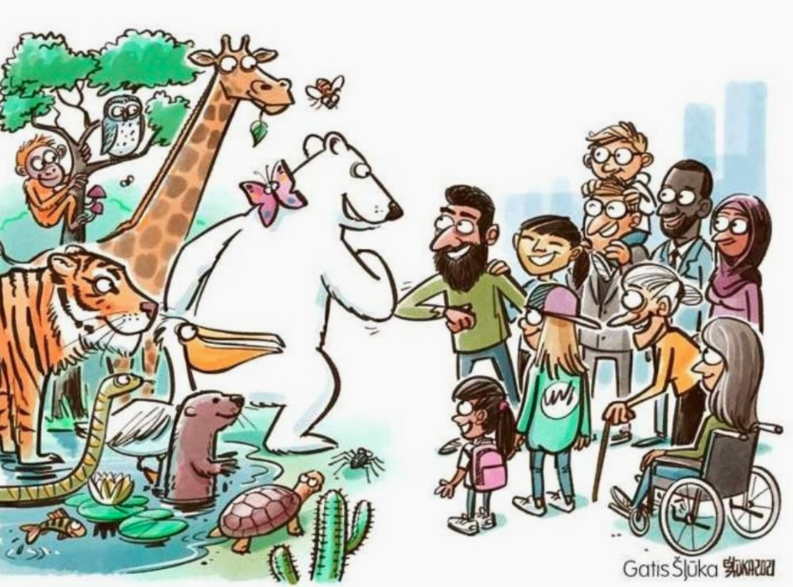
Desk research and observation/field research
Image source: https://www.instagram.com/p/CW6Fgx4IjyJ/

Slide 8
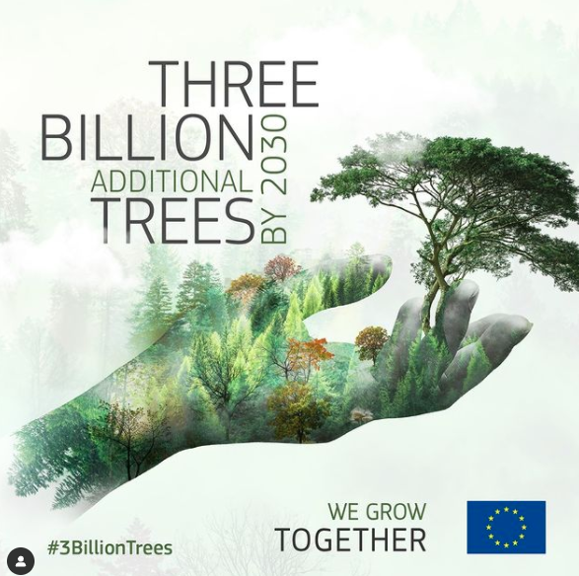
Debriefing
Trainers wraps up the session by running a questions and answers session to identify gaps in knowledge and addresses them.
Trainers briefs participants about Activity 3 which is optional homework.
Participants complete training evaluation form.
Image source: https://www.instagram.com/p/CXROqPRo_mf/

Slide 9
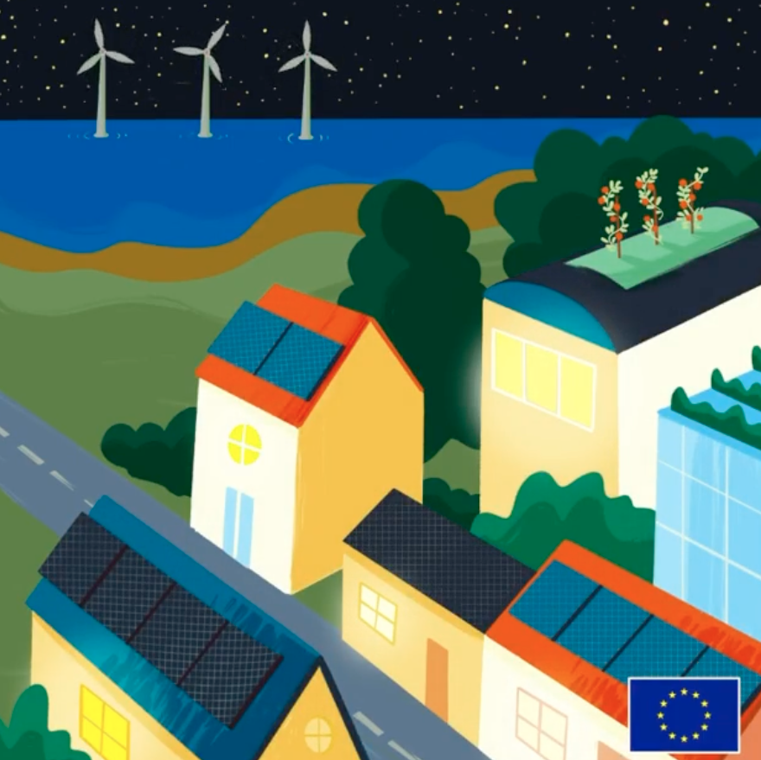
Activity: Teamwork
Participants identify which SDGs are specifically about environmental issues and discuss them in an open forum.
Participants select two local areas of their own choice (or this can be given to save time) to visit and investigate issues relating to the SDGs about the environment and climate.
Participants work in groups carry out observational research in the local areas they have chosen and investigate for issues to do with, for instance:
  Nuisances: noise pollution, odors and waste storage.
  Water: water discharge and wastage.
  Soil: soil pollution and erosion.
  Air pollution: odors, emissions, gasses.
  Energy: energy consumption and its impacts.
  Waste: plastic recycling.
  Health: healthy life-styles and eating.
Image source: https://www.instagram.com/p/CVh4sjeFb_p/

Slide 10
OERs
Article:
Marshall, C. & Rossman, G. B. (1989). Designing qualitative research. Newbury Park, p 79. CA: Sage.
Videos:
Observational Study in Statistics: Definition & Examples: https://study.com/academy/lesson/observational-study-in-statistics-definition-examples.html
Research Methods: Observations (Sociology Theory & Methods): https://youtu.be/OGXdorYr4Bg
Observation - Research Methods [A Level Psychology]: https://youtu.be/lSOjuEMAij4
Website:
Get it global aims to raise awareness on the grassroots level about global challenges: https://www.salto-youth.net/downloads/toolbox_tool_download-file-1413/T-Kit%20Get%20it%20global.compressed.pdf
Image source: https://www.instagram.com/p/CVh4sjeFb_p/

Slide 11









Any questions?
The European Commission's support for the production of this publication does not constitute an endorsement of the contents, which reflect the views only of the authors, and the Commission cannot be held responsible for any use which may be made of the information contained therein.
OUTSIDE - Open commUniTies for SustaInable DevelopmEnt Nr. 2020-1-IT02-KA201-079803

