Slide 1



Session 1 – Understanding green business enterprise & sustainable development
OUTSIDE module 6
Green Business Strategy
The European Commission's support for the production of this publication does not constitute an endorsement of the contents, which reflect the views only of the authors, and the Commission cannot be held responsible for any use which may be made of the information contained therein.
OUTSIDE - Open commUniTies for SustaInable DevelopmEnt Nr. 2020-1-IT02-KA201-079803

Slide 2
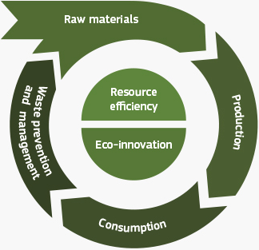
Introduction
This session examines how green strategic thinking can be integrated into a new business idea, aligning such an idea with sustainable development goals where necessary.
Session mapped to "Phase 1 OUTSIDE THE CLASSROOM"
Image source: https://ec.europa.eu/environment/green-growth/index_en.htm

Slide 3
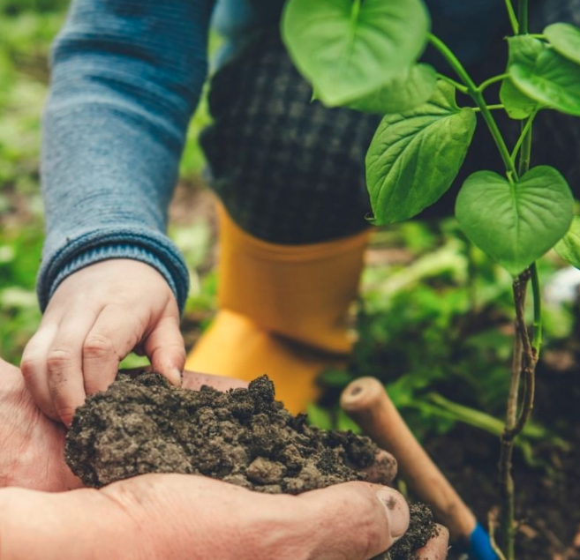
Session aim/purpose:
To introduce the concept of green business strategy and discuss sustainable development.
To explore the value of integrating green thinking into a business strategy.
To critique current green business strategies, highlight gaps, and leverage opportunities.
Image source: https://www.instagram.com/p/CVLQcxXolcw/

Slide 4
Session 1 outline
Activities breakdown | Duration
Slide Presentation: Explores green idea and opportunity generation as a business strategy, and review | 20 minutes
Activity: Teamwork and interaction - research, case study, and problem identification. | 60 minutes
Output: Group discussion, verbal presentation, and formative feedback. | 30 minutes
Feedforward: Formative feedforward to group, linking theory and concepts to a real-life scenario. | 15 minutes
Debriefing: Q&A session to identify gaps in learning and address them (Q&A, quiz, or case study). | 20 minutes
Activity 3: Personal reflection and optional homework. | 60 minutes
Assessment: Complete a training evaluation form | 5 minutes

Slide 5
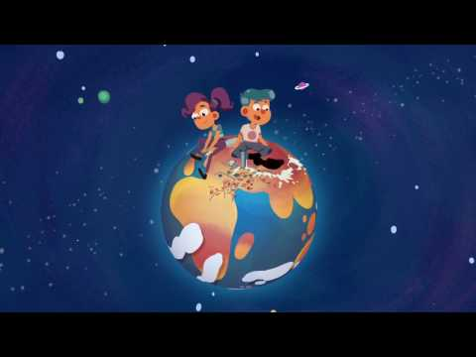
Group discussion
Video (3 mins +): Watch the video and discuss the importance of sustainable development (SD):
https://youtu.be/7V8oFI4GYMY
Group: Discuss SD issues in relation to the following subject areas:
climate and environment
social progress
economics development
YouTube video: https://youtu.be/7V8oFI4GYMY

Slide 6
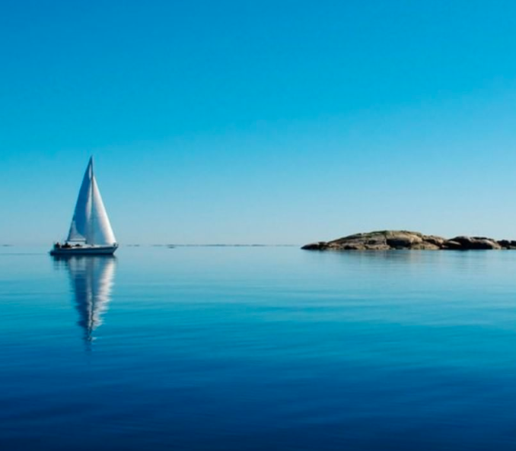
Note to trainer:
Slide Presentation: Exploring Sustainable Development Goals (SDGs) and Green Business Strategies
(20 minutes).
Refer and use the Module 6 Green Business Strategy descriptor information in the OUTSIDE Toolkit.
Adapt all content to suits the age range of 14 to 17 years.
Image source: https://www.instagram.com/p/CVLQcxXolcw/

Slide 7
Teamwork - Desk research, case study, and problem identification
Aim of the activities
The aim of the activities is to facilitate allow participants to engage in team work, where they carry out desk research to understand current issues around sustainable development and green business and to come up with an idea of their own.
Participants will work in teams to build an in-depth understanding and appreciation for sustainable development concerns, green economic trends, and green business strategies.

Slide 8
Research: Understanding green business enterprise & sustainable development
Think-Pair-Share: With reference to the SDG about environmental issues, participants will work in teams to conduct desk research and find examples of green business ideas, innovations, and practices that are (sustainable) positively impacting the world.
For instance, in any of the following area:
Life under water – Line fishing, fish farming vs trawling.
Renewable and clean energy – Wind farms, solar panels.
Responsible consumption and production – Recycling, local produce, biodegradable materials.
This task takes the form of desk research (Internet) and team discussion. Trainer to facilitate this session and encourage co-creation.

Slide 9
Activity instruction
60 minutes
Activity 1 - Team desk research:
Research and find three examples of green business ideas.
For each idea, state what is innovative about the idea.
For each idea, describe the green business practices/approach used.
For each idea, state the impact on environment, society, and business.

Slide 10
Activity instruction for the team presentation
30 minutes
Activity 2 - Verbal team idea presentation:
As a team, create slides to show your findings for Activity 1 and 2.
Appoint a spokesperson to present on behalf of your team.
Prepare to address questions and further the discussions.
Individual reflection: write a 100-word reflective summary for your e-journal.

Slide 11
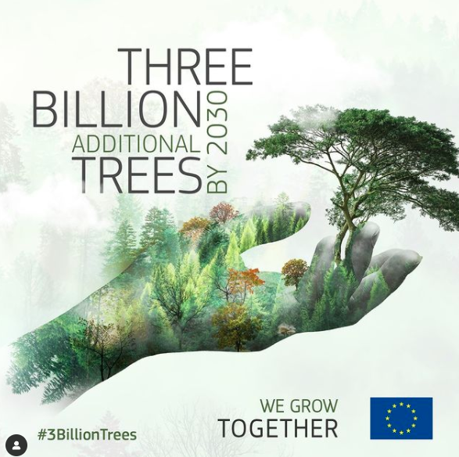
Debriefing
Trainers wraps up the session by running a questions and answers session to identify gaps in knowledge and addresses them.
Trainers briefs participants about Activity 3 which is optional homework.
Participants complete training evaluation form.
Image source: https://www.instagram.com/p/CXROqPRo_mf/

Slide 12









Any questions?
The European Commission's support for the production of this publication does not constitute an endorsement of the contents, which reflect the views only of the authors, and the Commission cannot be held responsible for any use which may be made of the information contained therein.
OUTSIDE - Open commUniTies for SustaInable DevelopmEnt Nr. 2020-1-IT02-KA201-079803

