Slide 1



Green Business Strategy Overview
Developing a sustainable green business venture
The European Commission's support for the production of this publication does not constitute an endorsement of the contents, which reflect the views only of the authors, and the Commission cannot be held responsible for any use which may be made of the information contained therein.
OUTSIDE - Open commUniTies for SustaInable DevelopmEnt Nr. 2020-1-IT02-KA201-079803
Notes:
https://www.youtube.com/watch?v=7V8oFI4GYMY

Slide 2
Explain Green Business Strategy
  Sustainable development (SD)
  Case study scenario
Discuss Green Opportunities & Idea Generation
Develop a Green Business Model Canvas
Explore Green Entrepreneurial Mindset
Final activity to sum up the sessions
Session overview
Notes:
1.0 – Introduction to Green Business & Sustainable Development
Participants will:
be able to understand and integrate sustainable development thinking into a business strategy/proposition.
2.0 – Green Opportunities & Idea Generation
Participants will:
be able to use a combination of idea generation techniques to formulate a green business idea and use a decision matrix to validate a green business value proposition.
3.0 – Developing a Green Business Model Canvas.
Participants will:
be able develop a BMC that is based on a green business strategy that aims to reduce a negative impact on the environment.
4.0 – Green entrepreneurial mindset and business activities
Participants will:
be able to develop a well-structured and justified business venture for a startup incubator.

Slide 3
“Green business strategy refers to the tendency to integrate environmental issues in business strategy, across sub-business functions such as manufacturing, supply chain, finance, human resources and marketing in international markets”.
Banerjee, S.B. (2002), “Corporate environmentalism: the construct and its measurement”, Journal of Business Research, Vol. 55 No. 3, pp. 177-191. Emerald Group Publishing Limited.
“green entrepreneurship” refers to the exploration of environmental challenges in a way that leverages positive outcomes on the natural environment using sustainable processes.
QAA Guidance for Enterprise and Entrepreneurship Education In Higher Education (2018)
Green business strategy

Slide 4
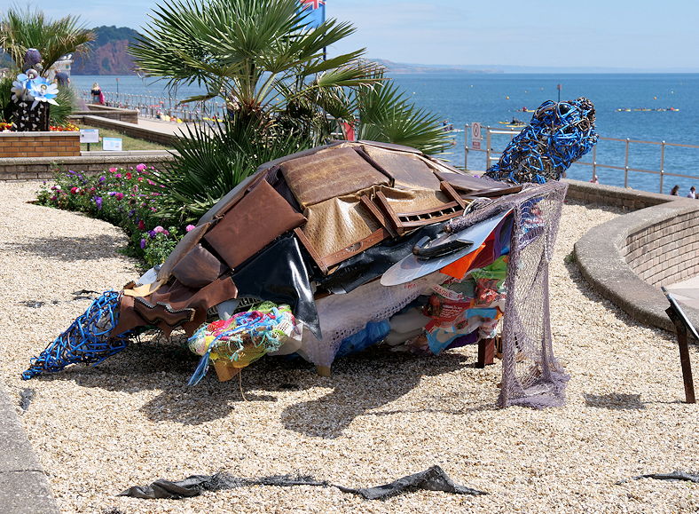
Open discussion
What environmental issues do you think the sculpture in this image highlights?
What message do you think this sculpture carries?
Can this sculpture be considered a green business idea?
The Chair Backed Turtle, Teignmouth Seafront - https://www.geograph.org.uk/photo/5857205
Notes:
The Chair Backed Turtle, Teignmouth Seafront
One of the sculptures in the 2018 TRAIL, Chair Backed Turtle was created by The ReStore (Refurnish) Sculpture Group LinkExternal link . Using items which have been donated but they are unable to recycle and so would otherwise be bound for landfill or incinerated, volunteers and staff from The ReStore (ReFurnish) have created a sculpture to communicate how plastic pollution and discarded household items that are sent to landfill or burnt can have an effect on the environment and wildlife. In particular, highlighting the threat to Turtles through pollution and global warming.
The Chair Backed Turtle, Teignmouth Seafront - https://www.geograph.org.uk/photo/5857205
What issues can you point out from this image:
- recycling and upcycling
- dealing with landfill and incineration
- destruction of the marine life
- impact on wildlife
- specific - threats to turtles
- water pollution
- plastic pollution
What do you think is the intention behind the sculpture?
- raising awareness of environmental issues
- local community awareness
Where is the green business opportunity in this image?
- sculpting, art industry, education
- collaboration volunteers and staff from The ReStore
- liaise with ReStore - get insight, feedback from firsthand experience
- call for redesign of household products and services

Slide 5
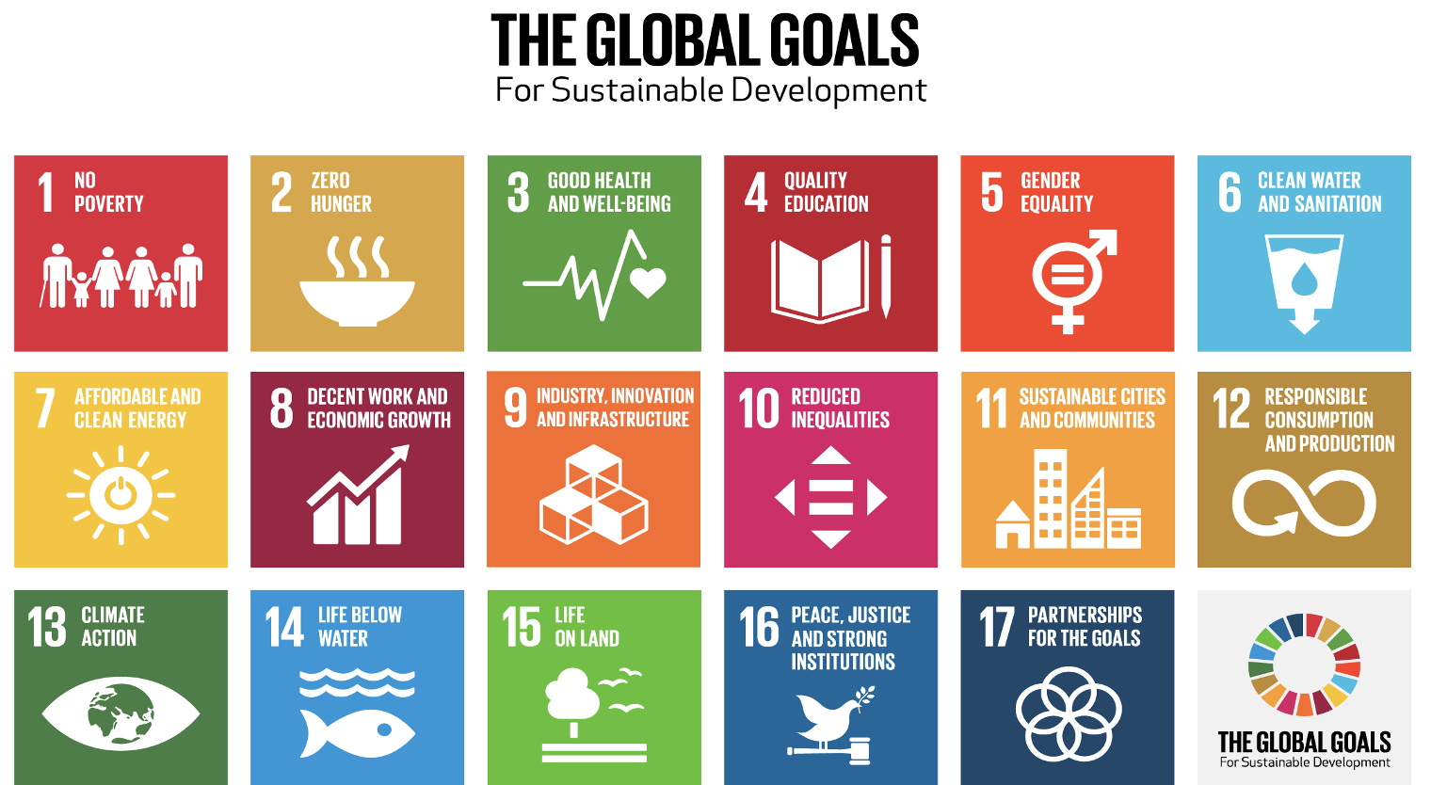
Sustainable development
Image source: https://www.un.org/sustainabledevelopment/news/communications-material/ (Adapted 22.09.21)
“Meeting the needs of the present without compromising the ability of future generations to meet their own needs”
World Commission on Environment and Development (WCED)
UN Brundtland Report “Our Common Future” 1987

Slide 6

Video (3 mins +): Watch the video and discuss the importance of sustainable development (SD):
https://youtu.be/7V8oFI4GYMY
Group: As a group discuss SD issues in relation to the following subject areas:
climate and environment
social progress
economics development
Activity: As a group, discuss possible barriers to change for just one of the subject areas listed above.
Session 1
15 mins

Slide 7
Video (4 mins +): For idea generation, watch the video on biodiversity on Edpuzzle and answer the questions as they are presented:
https://edpuzzle.com/media/5f285d5d61744a3f1ce0010a
Group: Group to discuss video on biodiversity and use the Idea Model to come up with a SD idea that relates to the subject area you identified in session 1.
Activity: As a group, complete the Idea Model template. Use the template to justify and refine your idea.
Session 2
15 mins

Slide 8

Video 1 (3 mins +): Watch a video on how to create a value proposition that meets real customer needs:
https://www.youtube.com/watch?v=ReM1uqmVfP0
Video 2 (2 mins +): Watch an example of a developed business model canvas example:
https://youtu.be/JXJeTfMplFs
Group: In your group, discuss both videos and relate them to your SD business idea from session 2.
Activity: As a group, complete a VPC and BMC for your business idea. Make sure you consider the green approach from slides 3, 4, and 5.
Session 3
15 mins

Slide 9

Video example: (5 mins +): Watch a video on BMC Interface Case study on Sustainable Business Model Innovation: https://youtu.be/Kr_1eaGAYKQ
Video 2 (3 mins +): Watch a video on "Entrepreneurial Mindset": https://youtu.be/FOFm8fPP2Kc
Group: Discuss video 1 & 2 in relation to your group VPC & BMC. Based on video 2 only:
highlight key skills you will need to develop your entrepreneurial mindset (in other words your .
How important is it to take action and ownership of your business idea from session 3?
Activity: complete the final activity on the next slide
Session 4
15 mins

Slide 10
Create a set of PowerPoint presentation slides that addresses the following:
Slide 1 OUTSIDE branded page showing; group business name and logo; mission statement; group project title; names of participants; session details and date.
Slide 2 Demonstrate understanding and awareness of SD & green business
Slide 3 Present biodiversity idea strategy using the Idea Model
Slide 4 Showcase BMC, giving full green business justification.
Slide 5 Present answers to session 4 group activity on this slide.
Slide 6 Provide group reflection on pros and cons of the sessions.
Slide 7 Provide referencing and any other useful resource found
Final activity
30 mins

Slide 11









Thanks for your attention!
Links to OERs resources used:
https://www.oercommons.org/courseware/lesson/70933/overview
https://edpuzzle.com/media/5f285d5d61744a3f1ce0010a
https://sa4d.org/de/was-wir-tun/projekte/girls-ahead/
https://www.youtube.com/watch?v=7V8oFI4GYMY
https://www.mti2.eu/post/innovation-ideas-on-a-napkin-how-to-make-it-work
https://www.youtube.com/watch?v=Kr_1eaGAYKQ
https://www.youtube.com/watch?v=JXJeTfMplFs
https://www.youtube.com/watch?v=ReM1uqmVfP0
https://www.youtube.com/watch?v=8NBnoVrLFPU
https://youtu.be/Kr_1eaGAYKQ
https://youtu.be/FOFm8fPP2Kc
The European Commission's support for the production of this publication does not constitute an endorsement of the contents, which reflect the views only of the authors, and the Commission cannot be held responsible for any use which may be made of the information contained therein.
OUTSIDE - Open commUniTies for SustaInable DevelopmEnt Nr. 2020-1-IT02-KA201-079803

