Slide 1

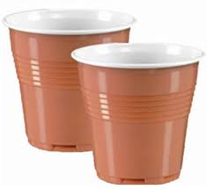
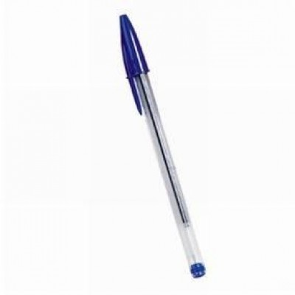


RUSH
AND
GET
The cup that will make you write

Slide 2

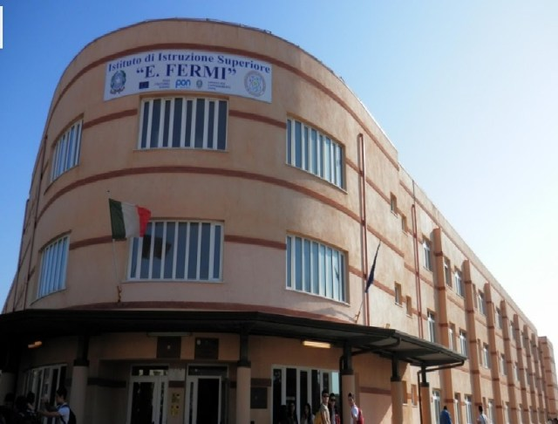


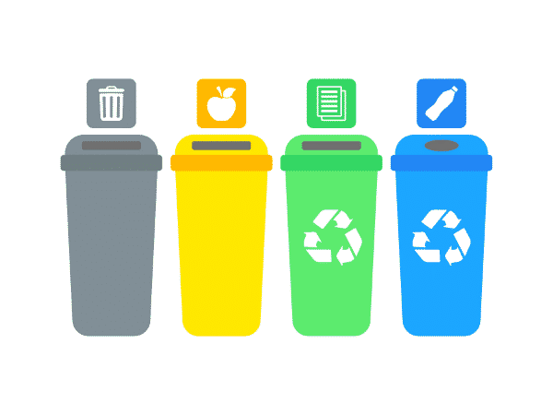
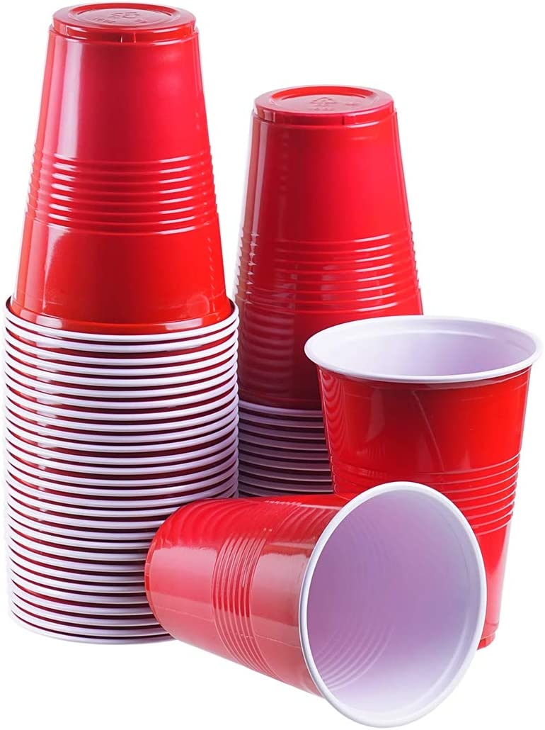
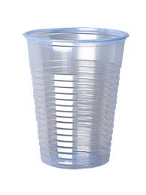
KEY PARTNERS:
Schools in our city;
Companies that recycle plastic.
KEY ACTIVITIES:
Recycling;
Teaching people how to recycle;
Giving a second life to plastic objects.
KEY RESOURCES:
Plastic cups

Slide 3


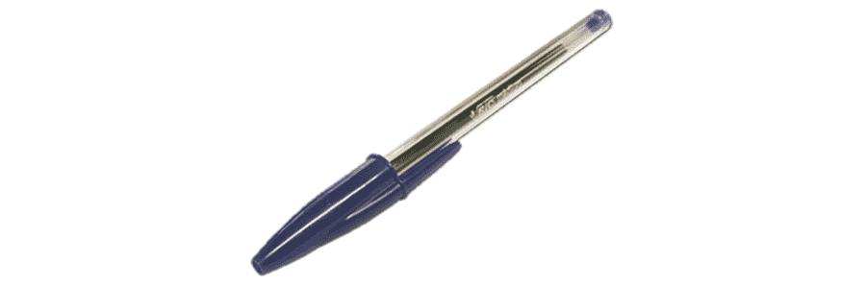
VALUE PROPOSITION:
REVENUE STREAMS:
Informing people about the importance of recycling;
Rewarding people for their good actions.
Recycled useful products;
Materials for the school.
An initial some of money to start the business;
The tax we give to the company to transform cups into pens.
COST STRUCTURE:

Slide 4





CUSTOMER SEGMENTS
Kids;
Teenagers;
Schools.
CUSTOMER RELATIONSHIPS
We want the clients to save money;
We want a positive feedback.
CHANNELS
Instagram;
TikTok;

