Slide 1

JEWERLY
Students of Merkinė Vincas Krėvė gymnasium.

Slide 2
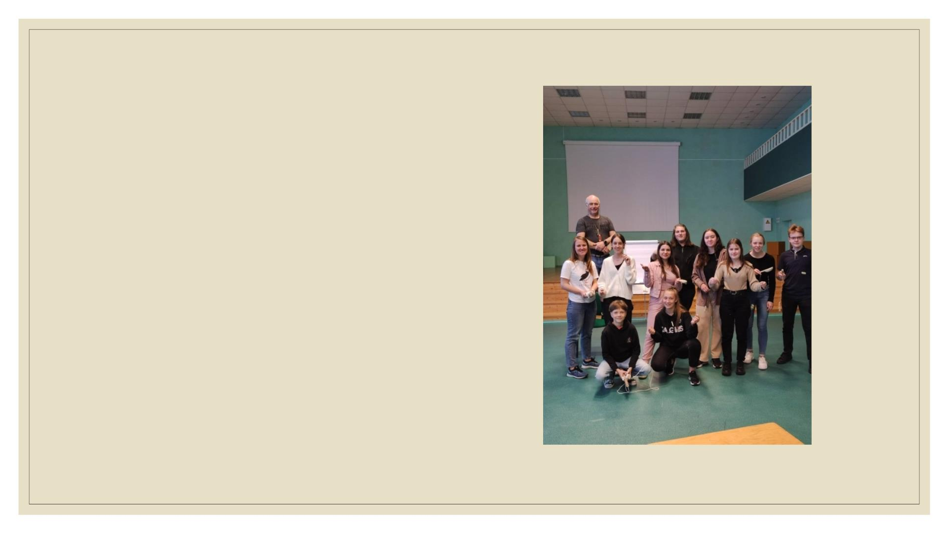
Our idea
◦ Our idea is to create a company that will
motivate each of us to preserve and protect
nature. We will produce jewelry that is
environmentally friendly and attractive to
people. We want to involve the community and
people of different generations.
◦ We try to encourage people to respect the
environment through the things that adorn them
every day - jewelry like earrings, bracelets,
rings, necklaces, key chains...
◦ We think that our idea is unique, and hope that
it will attract people's attention.

Slide 3
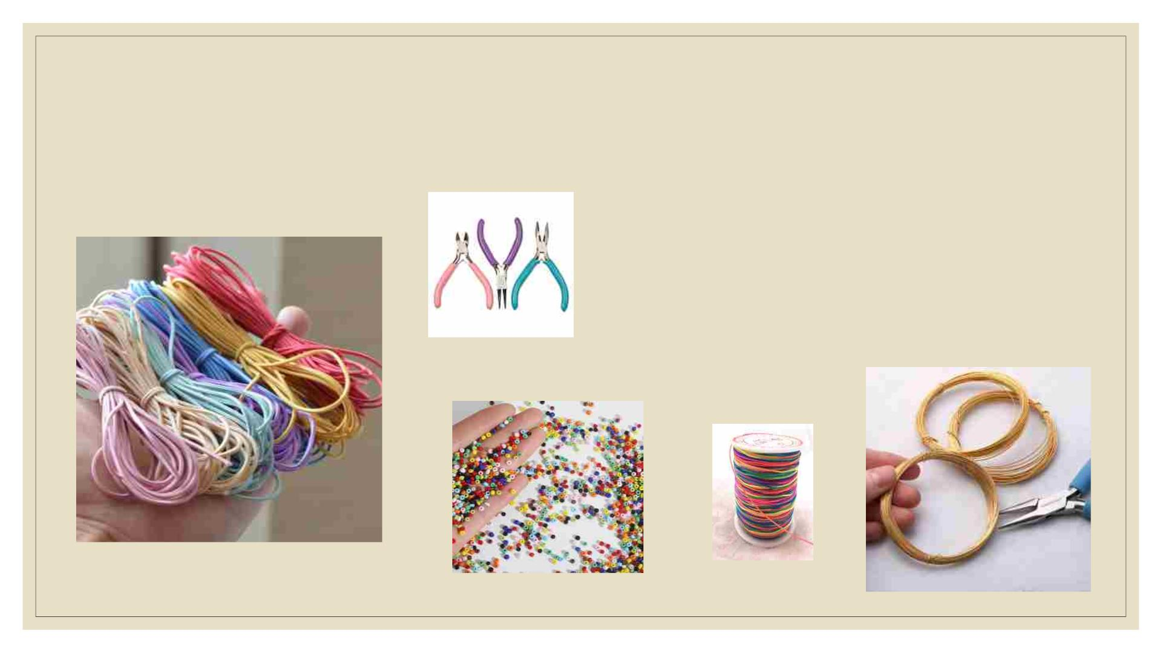
What materials will be used?
◦ Rings were made from wire, strung from beads.
◦ Bracelets were made of cord, beads and
pendants. Braided, knitted or crocheted.
◦ We also used tools that we found at home, such
as threads, beads and wire.

Slide 4
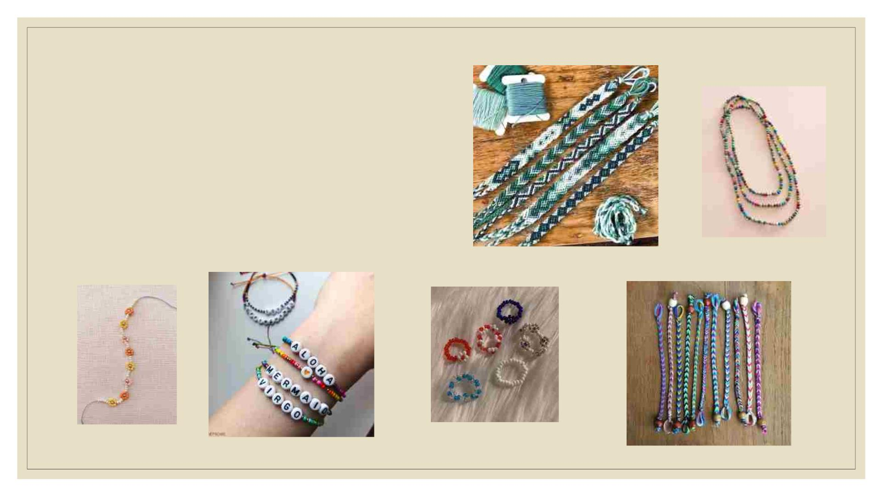
Who will help us?
◦ Help comes from trusted people who have
experience in jewelry making and can pass it
on. Organized workshops - trainings. Youtube"
material, "Pinterest" also helps.

Slide 5
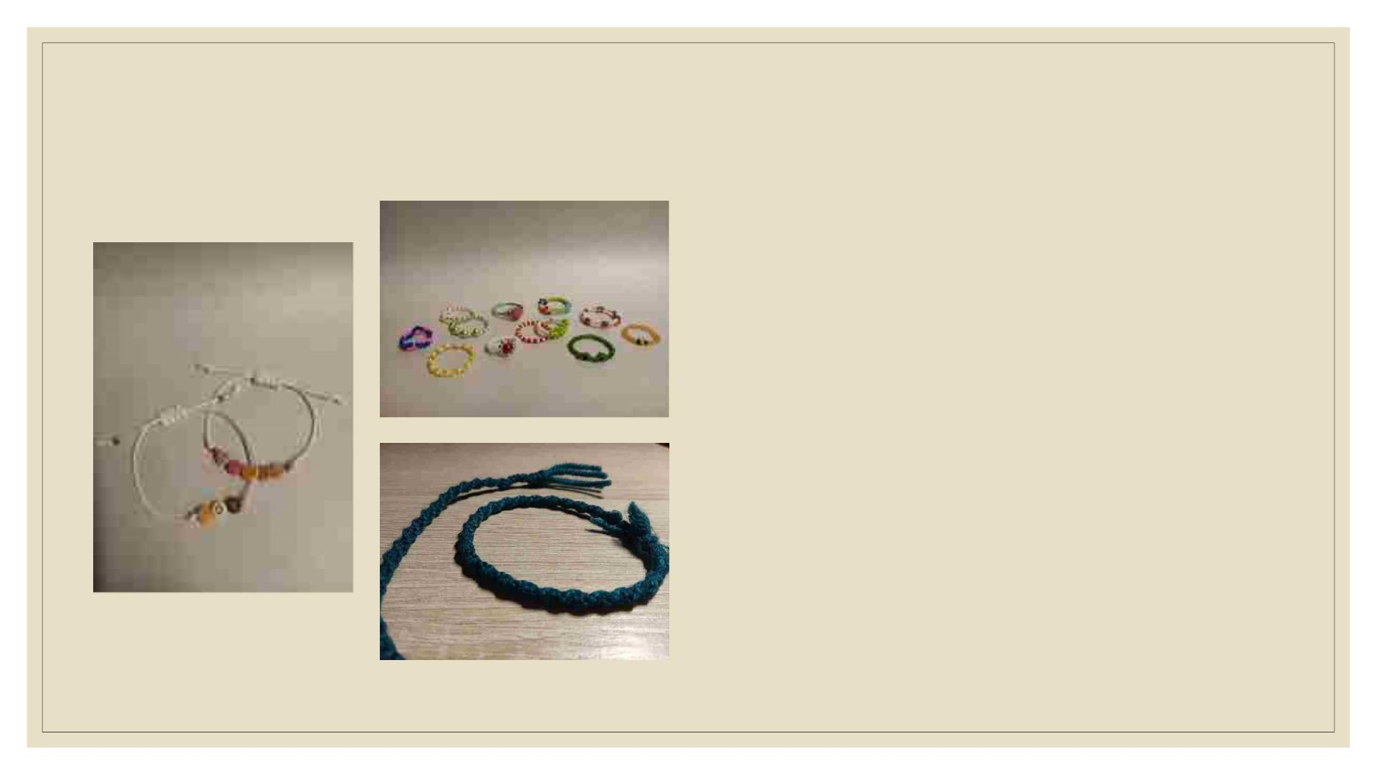
Why would customers want to buy our jewelry?
◦ Our jewelry is made from used materials or
those we find at home. This means that our
jewelry will be environmentally friendly. When
you wear it, you are helping to clean up the
environment.
◦ The jewelry will be unique and eco friendly, so
people will pay attention to it. This will benefit
both the person wearing the jewelry and us, the
manufacturers.

Slide 6
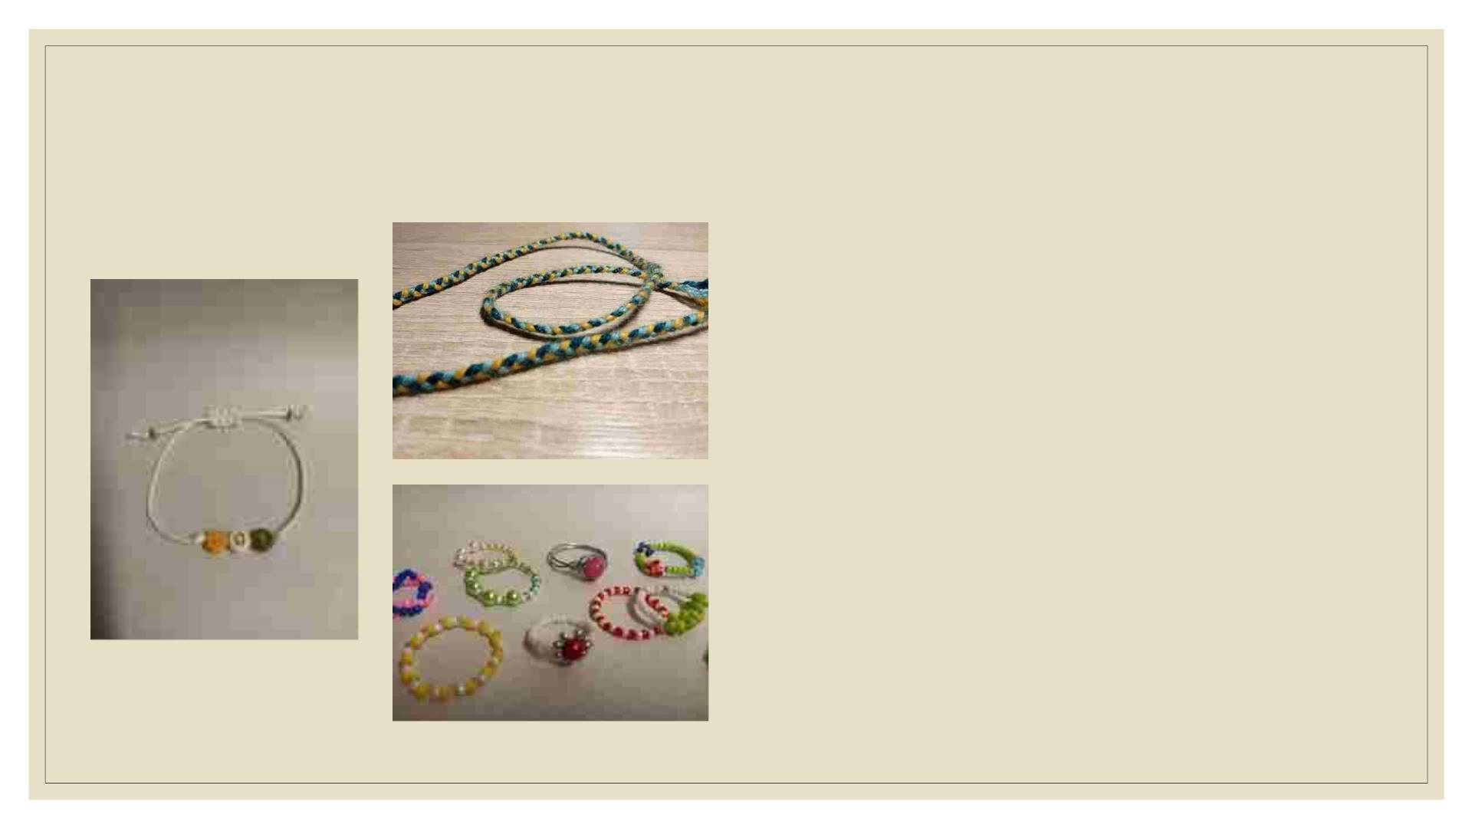
Making process
◦ Making jewelry was a really fun and
interesting. However, it was quite difficult to
make the jewelry with so little experience.
Sometimes we had difficulties, but working
together as a team, searching for information
on the internet and getting help from others
made everything much easier.
◦ We were really proud and happy with the final
products.

Slide 7
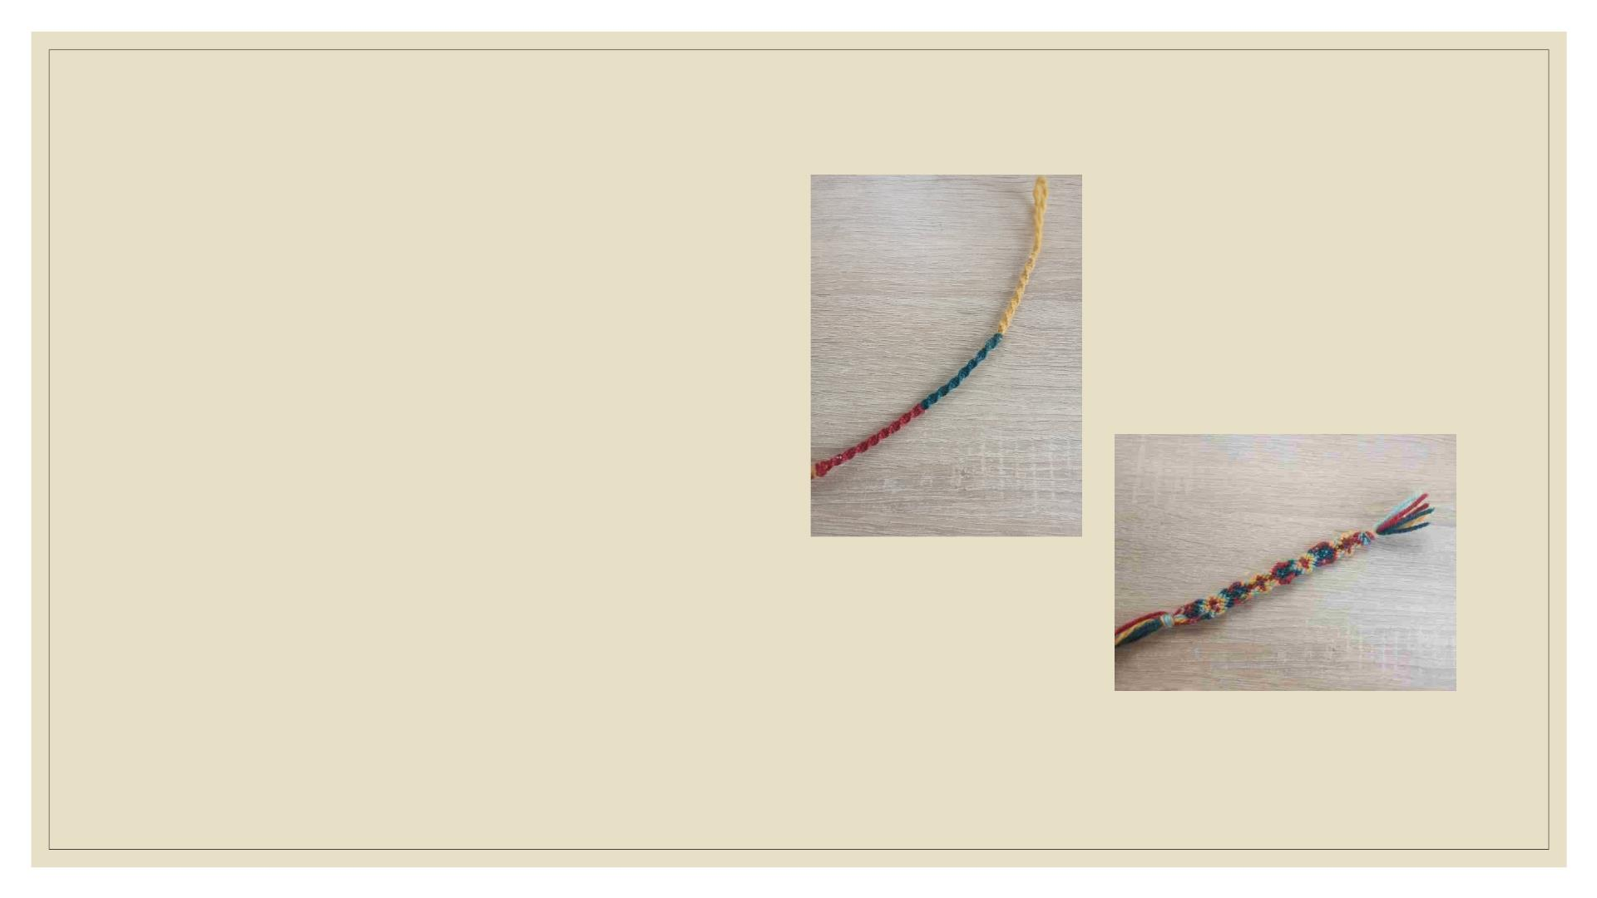
Final product
◦ We are very happy with the final result. But our
results don't stop there:
◦ We improved our team skills.
◦ We gained some business experience.
◦ We learned how to promote our product, how to
manage finances.
◦ We also improved our English skills.

